Slide 1
MoneyGuard Market Advantage® Variable universal life with long-term care
Long-term care planning
Help grow and protect your financial future
Not a deposit
Not FDIC-insured
May go down in value
Not insured by any federal government agency
Not guaranteed by any bank or savings association
MoneyGuard Market Advantage® is a variable universal life insurance policy with a long-term care rider that reimburses for qualified long-term care expenses.
Insurance products issued by: The Lincoln National Life Insurance Company
For use with the general public. The purpose of this communication is the solicitation of life insurance. A licensed insurance agent/producer will contact you.
ICC22LCN-4784044-061022 LCN-4784044-061022
Notes:
<Introduce yourself/topic of seminar.>

Slide 2
Agenda
MoneyGuard Market Advantage®
WHY
plan for LTC?
HOW
does it work?
WHY
MoneyGuard® solutions?
MoneyGuard Market Advantage® is a variable universal life insurance policy with a long-term care rider for qualified long-term care expenses. With any variable
life insurance product, certain fees and costs are involved, including monthly cost of insurance, administrative expense and premium load charges, as well as daily charges on assets invested in the variable subaccounts for mortality and expense risk, and asset management fees. Please consult the prospectus or ask your financial professional for more detailed information.
Notes:
Today, we’re going to discuss:
Why now is the time to plan for long-term care expenses
How a long-term care strategy can help you feel more comfortable about your financial future, and
Why you should consider MoneyGuard Market Advantage®
<Click>

Slide 3
WHY plan for LTC?

Slide 4
What is long-term care?
WHY plan for LTC?
It’s the need for assistance or supervision with the Activities of Daily Living (ADL):
If you lose the ability to independently perform at least two Activities of Daily Living for at least 90 days — or require substantial supervision due to a severe cognitive impairment — long-term care protection may help cover the costs.
Eating
Toileting
Bathing
Transferring
Dressing
Continence
Notes:
[Optional Slide]
What is long-term care?
It is ongoing help with daily activities. Most of the care needs do not relate to medical care aid, but rather assistance with the Activities of Daily Living (ADL), such as: Bathing, Dressing, Continence, Toileting, Transferring, Eating.
What does a long-term care solution do?
It helps take the financial consequences of an extended healthcare event off your portfolio and transfers that risk to an insurance company. It also provides a range of services to support you if you were to experience an extended care event. They help cover your expenses if you can no longer independently perform at least two ADL for at least 90 days, or if you require substantial supervision due to a severe cognitive impairment. Medicare will likely be insufficient, and Medicaid does not account for your choices or preferences.
Why plan now?
You want to begin saving for long-term care needs when you’re healthy and have more time to grow your benefits. Planning is also about preparing your loved ones for the tough emotional and financial decisions they may need to make on your behalf.

Slide 5
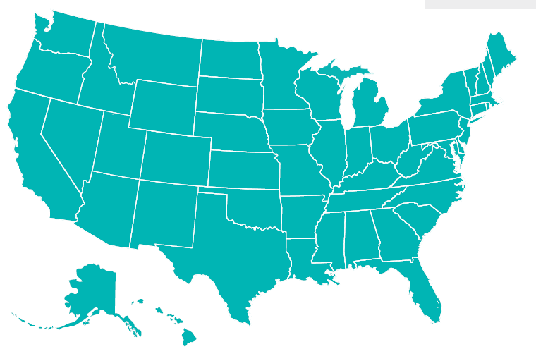
Planning for the cost of care
WHY plan for LTC?
What it costs
National average annual care costs¹
$116,435
Skilled nursing facility (private room)
$63,336
Assisted living facility (one-bedroom)
$90,480
Home health care agency (60 hours per week at $29 per hour)
¹ LTCG, “2022 Lincoln Financial Cost of Care Survey,” March 2023, www.whatcarecosts.com/lincoln. For a printed copy, call 877-ASK-LINCOLN.
Notes:
[Optional Slide]
When planning for long-term care, it’s important to consider the costs for the type of care you may want.
<Read slide>

Slide 6
Impact of a long-term care event
WHY plan for LTC?
The number of Americans providing unpaid care has increased over the last five years.¹
When you need long-term care and do not have a dedicated funding solution, it is estimated your annual portfolio withdrawal rate could jump from
53 million
Americans have
provided unpaid care.¹
61% of the time, the family caregiver is a woman.¹
5% to 11^{% 2}
¹National Alliance for Caregiving and AARP, May 2020, “2020 Report: Caregiving in the U.S.”
²Versta Research, “2020 LTC Marketing and Thought Leadership Research, Findings from Surveys of Advisors and Consumers,” August 2020. http://visit.lfg.com/MG-VRST-PPT001. For a printed copy, call 877-ASK-LINCOLN.
Notes:
Whose life is impacted by an extended care event?
It’s difficult, if not impossible, to predict when someone may need long-term care. Statistics show that women in the family are most often the ones who carry the burden of caregiving. <Read stats.>
Women tend to be the primary caregiver more often than men (61%), which could lead to time lost from their career, parenting their own children, leading a healthy lifestyle, enjoying family life and more.

Slide 7
What does planning do?
WHY plan for LTC?
87%
of Americans surveyed think having an LTC plan would help them feel more confident about their financial future.¹
Helps protect my hard-earned savings
Gives me more control over decisions affecting me and the freedom to choose my care preferences
Provides my loved ones resources and support to manage care
Helps me feel more confident about the future
Ensures my assets are passed to my loved ones
94%
of Americans surveyed believe a long-term care plan would make things easier on adult children.¹
¹ Versta Research, “2020 LTC Marketing and Thought Leadership Research, Findings from Surveys of Advisors and Consumers,” August 2020. http://visit.lfg.com/MG-VRST-PPT001. For a printed copy, call 877-ASK-LINCOLN.
Notes:
[Optional Slide]
<Read slide>

Slide 8
Planning is not about age – it’s about stage
WHY plan for LTC?
It’s never too early to start a conversation.
1
2
3
Who will provide care should you need it?
Where would you want to receive care?
How will you pay for it?
Notes:
[Optional Slide]
Have you answered any of these questions with your family and loved ones?

Slide 9
HOW does it work?

Slide 10
Access a wide range of portfolio options from leading investment managers
HOW does it work?
Customizable portfolio options
Use a model portfolio solution or build your own portfolio
Access target-date funds and tax-free exchanges to help keep your investment mix in line with your overall financial goals
Access to nearly 50 active and passive investment options from leading investment managers:
41
Actively managed portfolios
29
Morningstar categories
Long-term care benefits are set at time of claim and are based on the specified amount of death benefit and accumulation value in the policy. Benefit growth is not guaranteed, and unless on claim, values will increase and decrease daily due to selected investment option performance. Any LTC benefits paid will reduce the policy’s specified amount and accumulation value.
Notes:
MoneyGuard Market Advantage®, a variable universal life insurance policy, provides access to a wide range of investment options from leading investment managers to help you grow your long-term care benefits. By locking in a portion of that growth each year, you can feel more confident about staying invested in the markets and preparing for long-term care expenses.
<Read slide>

Slide 11
Align your strategy to your investment style
HOW does it work?
Make the investment decisions that are right for you.
If you’re the type of investor who:
Wants to select a preset portfolio allocation.
Likes the convenience to choose one fund that evolves over time based on your investment horizon.
Prefers to build your own portfolio.
Notes:
<Read slide>
Wants to select a preset portfolio allocation.
Choose from our menu of professionally managed asset allocation options if you’d like a simple alternative to selecting individual funds and monitoring their performance.
Likes the convenience to choose one fund that evolves over time based on your investment horizon.
Choose from professionally designed, all-in-one target-date investment options that fit your risk tolerance and time horizon.
Prefers to build your own portfolio.
Choose from diverse investment options ranging from large cap growth to emerging markets and more.

Slide 12
MoneyGuard Market Advantage® offers growth potential
HOW does it work?
At time of claim, LTC benefits will be the greatest of:¹
4x policy Accumulation Value
(LTC Market Value).
Whether or not you need care, your beneficiaries may receive an income tax-free death benefit.⁴
2.5x policy anniversary Accumulation Value,
which automatically locks in annually (LTC Protected Value).²
3-year initial minimum guaranteed long-term care benefit (LTC Base Value).³
This hypothetical chart shows how the policy features are designed to work. The data points and timeline are for illustration only and do not reflect any past or future policy investment option performance. If you have a 0% return on your policy’s investment options, you will receive your LTC Minimum Guaranteed Benefit as long as your policy is in-force. This is not a representation of what you would receive; request a personalized illustration from your financial professional.
Long-term care benefits are set at time of claim and are based on the specified amount of death benefit and accumulation value in the policy. Benefit growth is not guaranteed, and unless on claim, values will increase and decrease daily due to selected investment option performance. Any LTC benefits paid will reduce the policy’s specified amount and accumulation value.
¹Long-term care reimbursement amounts are subject to the monthly maximum. ²Assuming the Value Protection Rider is in-force and all requirements are followed. ³The LTC Base Value is set at issue and is based on the specified amount of death benefit of the VUL policy. Assuming all premiums are paid, no post-issue loans, withdrawals, increases or decreases. All guarantees and benefits of the insurance policy are subject to the claims-paying ability of the issuing insurance company. ⁴Beneficiaries may receive an income tax-free death benefit under IRC Section 101(a)(1).
Notes:
<Read slide>

Slide 13
A long-term care strategy that offers tax advantages
HOW does it work?
While it’s invested
Any growth is tax-deferred and will be income tax-free for qualified expenses. Transfers and rebalancing between investment options are also tax-free.¹
If you need it
When you need to access your benefits to cover qualified long-term care expenses, you can do so income tax-free.²
And if you don’t
If you don’t need long-term care, your benefits will be
passed on—income tax-free— through a death benefit.³
Long-term care benefits are set at time of claim and are based on the specified amount of death benefit and accumulation value in the policy. Benefit growth is not guaranteed, and unless on claim, values will increase and decrease daily due to selected investment option performance. Any LTC benefits paid will reduce the policy’s specified amount and accumulation value.
¹ Up to 24 transfer requests are available in any policy year. Lincoln reserves the right to charge a fee for each transfer in excess of 24 per year. A VUL policy is not designed to serve as a vehicle for frequent trading. Market timing is prohibited.
² LTC reimbursements are generally income tax-free under IRC Section 104(a)(3).
³ Beneficiaries may receive an income tax-free death benefit under IRC Section 101(a)(1).
Notes:
In addition to being able to harness the power of the markets, MoneyGuard Market Advantage® lets you grow your benefits and receive them income tax-free, which may provide value regardless of fluctuating tax rates over longer periods of time.
<Read slide>

Slide 14
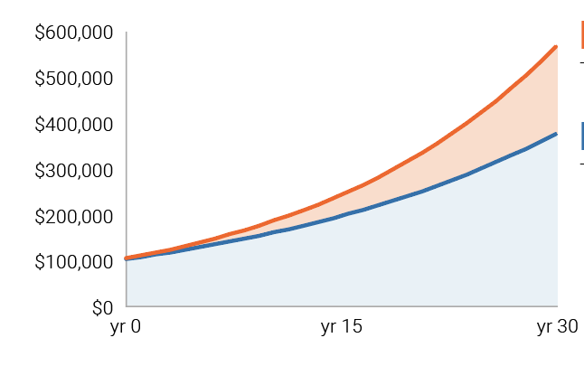
The impact of tax-deferred vs. taxable returns
HOW does it work?
Growth of $100,000 investment in a 24% tax bracket
$574,349
Tax-deferred growth
$381,037
Taxable growth
This “Impact of tax-deferred vs. taxable returns” chart is a hypothetical example for illustrative purposes only. Not related to any product performance; no fees and/or expenses are reflected. Example assumes initial investment of $100,000 earning 6% annually (net of expenses) over a 30-year period in a 24% federal tax bracket. “Taxable growth” assumes taxes were paid annually. State and local taxes were excluded. No loans or withdrawals were taken. Not intended to imply or predict any future results.
Notes:
[Optional Slide]
<Read slide>

Slide 15
WHY MoneyGuard® solutions?

Slide 16
Our 0-day elimination period saves you money
WHY MoneyGuard® solutions?
Our 0-day elimination period gives you access to your benefits sooner without incurring out-of-pocket costs, once qualified.¹
This much today
And even more in the future
Home health aide (60 hours/week)
$22,310
Assisted living facility (one bedroom)
$15,834
Nursing home (private room)
$28,710
Home health aide (60 hours/week)
$96,204
Assisted living facility (one bedroom)
$68,278
Nursing home (private room)
$123,802
Assumes 90-day costs using national averages.²
Assumes 90-day costs using national averages projected for 30 years with a 5% annual increase.²
¹ Lincoln will request an assessment be performed by a licensed health care practitioner to determine your benefit eligibility. If we provide the assessor, it will be provided at our expense. We may also choose to accept the assessment of your licensed health care practitioner. To be eligible for benefits, the licensed health care practitioner who performs the assessment must certify that you are chronically ill and unable to perform at least two activities of daily living (bathing, continence, dressing, eating, toileting, and transferring) for at least 90 days. You are also considered chronically ill if you require substantial supervision to protect you from threats to health and safety caused by severe cognitive impairment. Recertification of your benefit eligibility is required at least annually. ² LTCG, “2022 Lincoln Financial Cost of Care Survey," March 2023, www.whatcarecosts.com/lincoln. For a printed copy, call 877-ASK-LINCOLN.
Notes:
[Optional slide]
Our 0-day elimination period gives you access to your benefits sooner without incurring out-of-pocket costs.¹
<Read through slide>

Slide 17
Tailored to your lifestyle
WHY MoneyGuard® solutions?
In-home care
If you prefer to have assistance in your home
Assisted living
If you choose to downsize and prefer a social atmosphere
Nursing home
If you need more skilled care services
Flex Care Cash²
Access cash to compensate caregivers, including spouses or family members
Alternative care services³
Not covered by traditional services or options that may evolve in the future
Other care services: Caregiver training and care planning services, adult day care, respite care, hospice, bed reservation and non-continual services.
Lincoln MoneyGuard® solutions provide flexibility and customization for you and your loved ones¹
¹Care options/services are subject to the plan of care by a licensed healthcare practitioner.
²You can receive up to 50% of the maximum daily LTC benefit. Benefit is available as long as Base LTC value remains and informal care is approved as part of the Plan of Care.
³ These services are an alternative to services otherwise covered but are prescribed in the plan of care from a licensed health care practitioner.
Notes:
[Optional slide]
Let’s explore how Lincoln empowers you.
<Read slide>

Slide 18
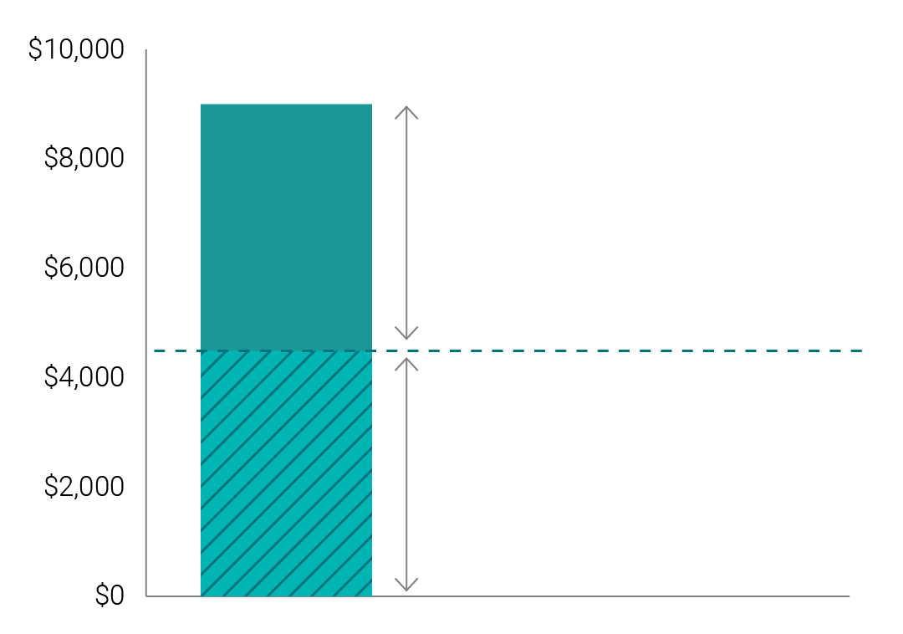
Flex Care Cash Benefits
WHY MoneyGuard® solutions?
Hypothetical example of how it works
At the time of claim, the plan of care includes an arrangement for the spouse to provide informal care.
$9,000 Max Monthly LTC Benefit
$4,500
Remaining unused max monthly LTC benefit¹
Benefits available at claim
Max monthly LTC benefit = $9,000
Flex Care Cash
Days of informal care provided by spouse (7 days)
$4,500
Flex Care Cash available
x
Half of the daily LTC benefit ($150)
$4,500 per month
(30-day month)
=
Actual values will vary for each client.
¹ The unused max monthly LTC benefit stays within the total LTC benefit pool.
Stay in control with a policy that provides convenience and flexibility for today and tomorrow.
Notes:
[Optional slide]
MoneyGuard solutions seek to provide long-term care benefits that are flexible, customized and evolve with changing care needs.
Our solutions let you access receipt-free cash through Flex Care Cash benefits to compensate caregivers, including spouses or family members.
Using this feature, you may receive cash, equal to half of the daily LTC benefits, to pay for informal care. Plus, you still keep the remaining balance of your Max Monthly LTC benefit for reimbursement of qualified LTC expenses.
With MoneyGuard Market Advantage, Flex Care Cash is available as long as the Base LTC value remains and informal care is approved as part of your Plan of Care.
With MoneyGuard Fixed Advantage, Flex care cash is available as long as the specified amount remains and informal care is approved as part of the Plan of Care.
<Read slide and walk through example>

Slide 19
Benefit Transfer Rider
WHY MoneyGuard® solutions?
BTR is included at issue for no additional cost
Beneficiaries have these three options:¹
They can take the full death benefit amount income tax-free.²
Use full death benefit to purchase more benefits on their own policy.³
Take partial death benefit income tax-free² and use remainder to purchase more benefits on their own policy.³
¹ To qualify for benefits both the insured and beneficiary must be policyholders, the Benefit Transfer Rider must be on both policies and the beneficiary must be the insured on their policy. The minimum BTR purchase amount is $25,000 and can not be funded prior to attained age 50.
² Beneficiaries may receive an income tax-free death benefit under IRC Section 101(a)(1). If the beneficiary choses to take the full death benefit it is not part of the Benefit Transfer Rider.
³ Underwriting is not required for the death benefit or long-term care benefit purchased through the Benefit Transfer Rider.
Notes:
All policies include the Benefit Transfer Rider at issue for no additional cost. This is how the BTR works:
To qualify for benefits the following needs to apply:
Both the insured and beneficiary are policyholders.
The Benefit Transfer Rider is active on both policies.
Beneficiary is the Insured on their policy.
Beneficiaries have these three options:
They can take the full death benefit income tax-free.¹
Use the full death benefit to purchase more benefits on their own policy.²
Take a partial death benefit income tax-free¹ and use remainder to purchase more benefits on their own policy.²

Slide 20
Lincoln Concierge Care Coordination
WHY MoneyGuard® solutions?
Your care should revolve around you. Build a plan to meet your needs.
Create a personalized action plan
Get help building a care plan that provides resources and recommendations for the care to fit your needs.
Explore provider services
See what’s available from skilled nursing to home healthcare and community options.
Access an online library
Find information, such as third-party articles, videos and checklists on health, aging and elder care.
A version of Lincoln Concierge Care Coordination is available for Lincoln MoneyGuard® Solutions policyowners. However, the tools, resources and services may change or evolve over time. All information is current as of the created date of this material.
Notes:
[Optional slide]
Thinking about your care preferences may seem overwhelming, which is why we provide Lincoln Concierge Care Coordination at the time you purchase a MoneyGuard® Solution.
Our care planning resources provide you with complimentary access to the resources and flexibility needed to plan over time and better assist your loved ones.
<Read slide>

Slide 21
The advantage of decades of claims-paying expertise¹
WHY MoneyGuard® solutions?
File a claim through our streamlined process either online or by phone.
Set up direct billing to caregivers and direct deposit to receive and manage your funds easily.
Access your long-term care funds quickly and seamlessly.
With 30+ years expertise in developing long-term care solutions and more than 115 years of financial stability,² Lincoln remains steadfastly committed to equipping our customers with the strategies they need to accomplish their goals.
Dedicated support to help you and your loved ones.
¹ Lincoln MoneyGuard® solutions have been sold since 1988.
² The Lincoln National Life Insurance Company was established in 1905.
Notes:
[Optional Slide]
Along with our tools that enable you and your loved ones to build a plan over time, Lincoln also provides you with a dedicated Care Specialist should you need care.
They will offer you personalized support and act as your point of contact throughout the entire claims process.
Also, if you have more than one claim during the duration of your policy, those subsequent claims will be handled by the same Care Specialist who was assigned your initial claim.
<Read slide>

Slide 22
MoneyGuard Market Advantage®
WHY MoneyGuard® solutions?
WHY plan?
HOW does it work?
WHY MoneyGuard solutions?
Protection for portfolio and loved ones
Freedom to choose care preferences
Feel more confident in the future
More control and flexible options with the Benefit Transfer Rider
LTC benefit growth potential through investment performance equal to 4x your policy accumulation value
Annual lock-ins to protect against a prolonged market downturn equal to 2.5x your policy anniversary accumulation value
3-year initial minimum guaranteed long-term care benefit
Favorable tax treatment to maximize benefit values
Should care not be needed, an income tax-free death benefit is passed on to beneficiaries
Access to benefits as soon as care is needed
Care planning resources
Flexible, customizable covered care services
Decades of claims-paying expertise
Notes:
<read slide>

Slide 23
Your next step
WHY MoneyGuard® solutions?
Connect with your financial professional and have a long-term care planning conversation to see if MoneyGuard Market Advantage® is the right strategy for you.
Start the conversation and answer these three questions:
1
Who will provide care should you need it?
2
Where would you want to receive care?
3
How will you pay for it?
Notes:
<Read slide>

Slide 24
Thank you.
Notes:
Thank you for listening to our presentation today.
Talk to your financial professional to learn more. Let’s take the next step and start the planning process.
<Review disclosures and thank audience.>

Slide 25
Important information
Insurance products issued by:​ The Lincoln National Life Insurance Company​
Lincoln variable universal life insurance is sold by prospectus. Carefully ​consider the investment objectives, risks, and charges and expenses of the policy and its underlying investment options. This and other important information can be found in the prospectus for the variable universal life ​policy and the prospectuses for the underlying investment options. Prospectuses are available upon request and should be read carefully ​before investing or sending money. For current prospectuses, please ​call 800-444-2363 or go to www.LincolnFinancial.com.​
With variable products, policy values will fluctuate and are subject to market risk and to possible loss of principal.​
Products, riders and features are subject to state availability. Limitations and exclusions apply.​
Lincoln Financial Group® affiliates, their distributors, and their respective employees, representatives and/or insurance agents do not provide tax, accounting or legal advice. ​
Please consult an independent professional as to any tax, accounting or legal statements made herein.​
Lincoln Concierge Care Coordination is available for all Lincoln MoneyGuard® Solutions policyowners.​
Lincoln Concierge Care Coordination includes claims support provided by Lincoln Financial and services provided by a third-party vendor not affiliated with Lincoln Financial. Concierge Care third-party vendors do not provide direct care or home services. Participating providers are not agents or employees of Lincoln Financial Group or the third-party vendor. Results and outcomes cannot be guaranteed. The availability of any particular provider cannot be guaranteed and is subject to change. Lincoln Financial does not monitor or participate in the review of programs or services referred or recommended by third-party vendors. Long-term care coverage is provided through the applicable long-term care rider offered through your Lincoln policy.​
All guarantees and benefits of the insurance policy are subject to the ​claims-paying ability of the issuing insurance company. They are not backed by the broker-dealer and/or insurance agency selling the policy, or any affiliates of those entities other than the issuing company affiliates, and none makes any representations or guarantees regarding the claims-paying ability of the issuer.​ In most cases, based on our understanding of applicable law, the policy will be a Modified Endowment Contract (MEC) as defined in section 7702A of the Internal Revenue Code.​
We will not deny benefits for pre-existing conditions. This does not preclude us from exercising other remedies available at law, in equity or in contract because of misrepresentations. A pre-existing condition means a condition for which medical advice or treatment was recommended by or received from a provider of health care services within 6 months preceding the effective date of coverage of an insured person.
Distributions from a MEC will be subject to income tax, and an additional 10% federal income tax penalty applies to taxable distributions received before the policy owner reaches age 59½.​
Notes:
REVIEW PRODUCT DISCLOSURES.

Slide 26
Important information
MoneyGuard Market Advantage® is a variable universal life insurance policy with a Long-Term Care Benefits Rider (LTCBR) that accelerates the specified amount of death benefit to pay for covered long-term care expenses and continues ​long-term care benefit payments after the entire specified amount of death benefit has been paid. Any surrender benefit provided will be adjusted by any loans/loan interest/loan repayments, withdrawals taken, and claim payments made. The cost of riders will be deducted monthly from the policy accumulation value. The insurance policy and riders have limitations, exclusions and reductions. Renewability, Termination and Cancelability: The LTCBR is noncancelable. This means you have the right, subject to the terms of your policy and rider(s), to continue this rider as long as your policy stays in-force. The Lincoln National Life Insurance Company cannot change any of the terms of your policy and rider(s) on its own and cannot increase the monthly rider charges or monthly inflation charges. If your policy enters a grace period, we will allow 61 days to pay a premium sufficient to prevent your policy form lapsing. The Long-Term Care Benefit Rider may not cover all costs associated with long-term care costs incurred by the insured during the coverage period. All contract provisions, including limitations and exclusions, should be carefully reviewed by the owner. For costs and complete coverage details, contact your financial professional.​
MoneyGuard Market Advantage® is issued by The Lincoln National Life Insurance Company, Fort Wayne, IN on Policy Form ICC20-MGV892/20-MGV892 with a Long-Term Care Benefits Rider (LTCBR) on Rider Form ICC20LTCBR-892/LTCBR-892, a Value Protection Rider on Form ICC20VPR-892/VPR-892 and a Benefit Transfer Rider on Form ICC22BTR-895/BTR-895. Distributed by Lincoln Financial Distributors, Inc., a broker-dealer.​
The LTCBR is intended to be a qualified long-term care insurance contract under Section 7702B(b) of the Internal Revenue Code. ​
Your Specified Amount is the amount used to determine the amount of death benefit and the amount of Long-Term Care Benefits Rider benefits. You will select the Initial Specified Amount of death benefit on the application. ​
The insurance policy and riders have limitations, exclusions and reductions; and are subject to medical underwriting. Long-term care benefit riders may not cover all costs associated with long-term care costs incurred by the insured during the coverage period. All contract provisions, including limitations and exclusions, should be carefully reviewed by the owner. For costs and complete coverage details, contact your agent or producer. A version of Lincoln Concierge Care Coordination is guaranteed for Lincoln MoneyGuard® Solutions policyowners. However, the tools, resources and services may change or evolve over time.​
All information is current as of the created date of this material.​
For use in all states except: NY and CA.
Notes:
REVIEW PRODUCT DISCLOSURES.

