Slide 1
Brought to you by Lincoln Advanced Sales Solutions
10-Minute Sales Concept
Spousal Lifetime Access Trusts (SLATs)
Not a deposit
Not FDIC-insured
May go down in value
Not insured by any federal government agency
Not guaranteed by any bank or savings association
Insurance products issued by:
The Lincoln National Life Insurance Company Lincoln Life & Annuity Company of New York
LCN-5467393-021423
For financial professional use only. Not for use with the public.
©2023 Lincoln National Corporation
1
Notes:
Hello, my name is [insert name a title] with Lincoln Financial Distributors. Welcome to a discussion of Spousal Lifetime Access Trusts, also known as Spousal Limited Access Trusts, or SLATs. When many people hear about financial planning with trusts, they think of “trust funds” for the ultra-affluent and their families. However, Trusts are not exclusively for the ultra-affluent. They can offer asset control, legacy protection, financial privacy, probate avoidance, and estate tax mitigation for those of all income levels

Slide 2
What is a SLAT?
Notes:
So what is a SLAT? A SLAT is an irrevocable trust that provides married couples a way to pass wealth tax-efficiently to their children, grandchildren, and future generations while giving a spouse access to trust assets during and after the insured spouse’s lifetime. This type of trust is typically funded with a permanent, single-life, life insurance policy on the life of the grantor. By making the insured the only grantor, the spouse gains access to policy account values from trust distributions as a beneficiary of the trust, while simultaneously keeping the death benefit proceeds out of the insured’s estate.

Slide 3
Simon and Eden
SLATs
Simon, 40-year-old male |  | Eden, 39-year-old female |  | Married with two young kids
Goals
Set up supplemental retirement income source for Eden
Supplement life insurance coverage on Simon
Notes:
To illustrate this concept, let’s look at a case study. Meet Simon and Eden.
Simon is age 40 and owns a successful fishing business. He is married to his wife, Eden, age 39. Together, they have two young kids. When their first child was born, Eden decided not to return to full time work after her maternity leave. The couple appreciated this decision even more when their second child was born; it has saved them the added expense of childcare every day and has allowed Eden to spend more time with her young children. However, when Eden left her full time position, she also lost the ability to contribute to a 401(k) plan. The couple has already done some financial planning as they are concerned about estate taxes and the needs of the business, so they have life insurance in place. Following the births of their children, they now have two additional goals: to set up a supplemental retirement income source for Eden and to supplement the life insurance on Simon’s life as he is the family’s primary bread winner.

Slide 4
Simon and Eden
SLATs
Simon, 40-year-old male |  | Preferred non-tobacco |  | $350,000 Lincoln AssetEdge® VUL
How the solution works
Simon’s gifted premium = $20,000 x 25 years
Eden’s income via fixed policy loans = $100,000 years 26-45 (her ages 65-84)
At Simon’s death, residual death benefit paid to trust
Assumes Lincoln AssetEdge VUL with Enhanced Allocation Rider, 40-year-old male, preferred non-tobacco, $350,000 initial death benefit, $20,000 annual premium paid for 25 years, monthly fixed loans years 26-45, 6.5% gross rate of return, issued in the state of Washington. Coverage is guaranteed for 20 years and carries through maturity on a current basis.
Notes:
[May hide slide depending on audience]
After speaking with their financial advisor, he recommends working with an attorney to establish a SLAT, which will own a $350,000 AssetEdge VUL policy on Simon. After going through the underwriting process, Simon is offered preferred non-tobacco.
Simon decides to gift $20,000 each year to the SLAT for the next 25 years to fund the premium of the AssetEdge policy. As you’ll recall from a previous video, this is well below his annual gift tax exclusion being married and with multiple trust beneficiaries. Eden can then take policy loans of $100,000 starting at her age 65 for 20 years, which she can use for her own health, education, maintenance, and support (also commonly referred to as for “HEMS”). The children may even have limited access to trust distributions while their parents are alive and will also benefit from the trust’s assets following both their parents’ deaths.
Speaker note: NLG period is 20 years

Slide 5
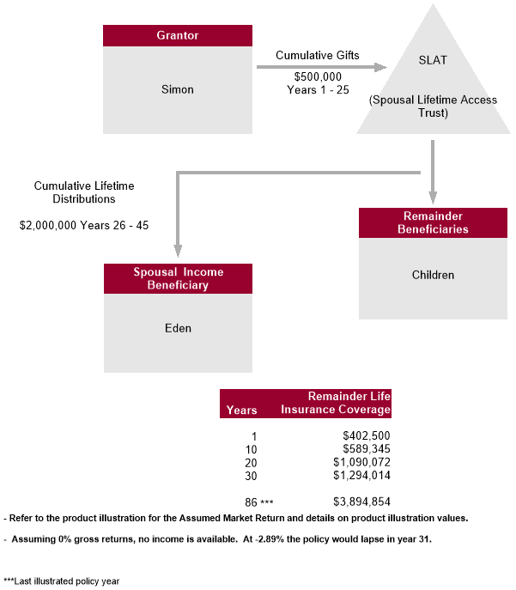
Flow chart
SLATs
Assumes Lincoln AssetEdge VUL with Enhanced Allocation Rider, 40-year-old male, preferred non-tobacco, $350,000 initial death benefit, $20,000 annual premium paid for 25 years, monthly fixed loans years 26-45, 6.5% gross rate of return, issued in the state of Washington. Coverage is guaranteed for 20 years and carries through maturity on a current basis.
Notes:
[May hide slide depending on audience]
Presented another way, here is a flow chart of the strategy. As you can see, Simon has gifted $500,000 to the SLAT over 25 years, thus reducing his estate by this amount. This allows for Eden to take a total of $2,000,000 of income from the trust over 20 years, income tax free. There is also a residual death benefit on Simon’s life, which will be paid to the trust at his death. According to this illustration, the death benefit will be over $1M by year 20 and will benefit the children’s future. Furthermore, it will avoid estate inclusion for Simon and Eden.

Slide 6
Simon and Eden
SLATs
Simon, 40-year-old male |  | Preferred non-tobacco |  | $350,000 Lincoln WealthAccumulate® 2 IUL
How the solution works
Simon’s gifted premium = $20,000 x 25 years
Eden’s income via fixed policy loans = $100,000 years 26-45 (her ages 65-84)
At Simon’s death, residual death benefit paid to trust
Assumes Lincoln WealthAccumulate 2 IUL, 40-year-old male, preferred non-tobacco, $350,000 initial death benefit, $20,000 annual premium paid for 25 years, monthly fixed loans years 26-45, 6.27% interest rate, issued in the state of Washington. Coverage is guaranteed for 27 years and carries through maturity on a current basis.
Notes:
[May hide slide depending on audience]
After speaking with their financial advisor, he recommends working with an attorney to establish a SLAT, which will own a $350,000 WealthAccumulate 2 IUL policy on Simon. After going through the underwriting process, Simon is offered preferred non-tobacco.
Simon decides to gift $20,000 each year to the SLAT for the next 25 years to fund the premium of the AssetEdge policy. As you’ll recall from a previous video, this is well below his annual gift tax exclusion being married and with multiple trust beneficiaries. Eden can then take policy loans of $100,000 starting at her age 65 for 20 years, which she can use for her own health, education, maintenance, and support (also commonly referred to as for “HEMS”). The children may even have limited access to trust distributions while their parents are alive and will also benefit from the trust’s assets following both their parents’ deaths.
Speaker note: NLG period is 27 years

Slide 7
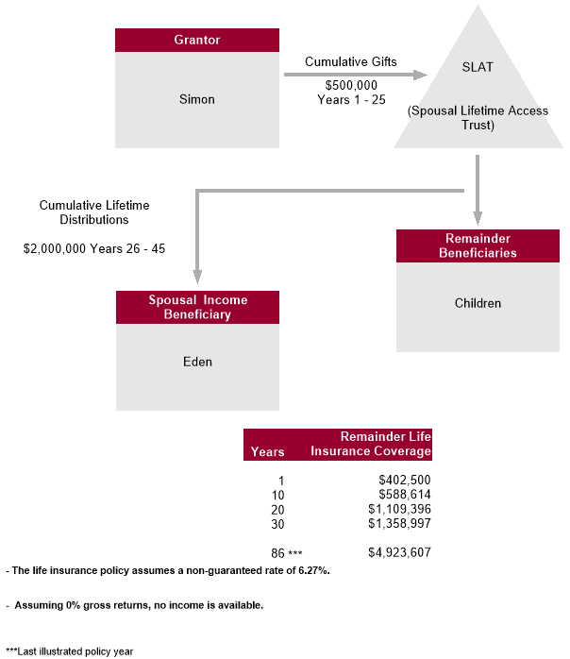
Flow chart
SLATs
Assumes Lincoln WealthAccumulate 2 IUL, 40-year-old male, preferred non-tobacco, $350,000 initial death benefit, $20,000 annual premium paid for 25 years, monthly fixed loans years 26-45, 6.27% interest rate, issued in the state of Washington. Coverage is guaranteed for 27 years and carries through maturity on a current basis.
Notes:
[May hide slide depending on audience]
Presented another way, here is a flow chart of the strategy. As you can see, Simon has gifted $500,000 to the SLAT over 25 years, thus reducing his estate by this amount. This allows for Eden to take a total of $2,000,000 of income from the trust over 20 years, income tax free. There is also a residual death benefit on Simon’s life, which will be paid to the trust at his death. According to this illustration, the death benefit will be over $1.1M by year 20 and will benefit the children’s future. Furthermore, it will avoid estate inclusion for Simon and Eden.

Slide 8
How many clients do you have who ...
Target market
Are concerned about estate taxes?
Want to pass assets on to future generations?
Have a spouse who needs additional income during their lifetime?
Notes:
[Read slide]

Slide 9
How can Lincoln help?
Resources
Advanced Markets Resource Center (AMRC)
Lincoln DesignItSM Sales Module
Contains flow chart
Advanced Sales
Notes:
[Read slide]

Slide 10
Thank You
Notes:
Thank you for your attention. I’d now like to open it up for Q&A.

Slide 11
Disclosures
Issuers: The Lincoln National Life Insurance Company, Fort Wayne, IN The Lincoln National Life Insurance Company does not solicit business in the state of New York, nor is it authorized to do so.
All guarantees and benefits of the insurance policy are subject to the claims-paying ability of the issuing insurance company. They are not backed by the broker-dealer and/or insurance agency selling the policy, or any affiliates of those entities other than the issuing company affiliates, and none makes any representations or guarantees regarding the claims-paying ability of the issuer.
In some states, contract terms are set out and coverage may be provided in the form of certificates issued under a group policy issued by The Lincoln National Life Insurance Company to a group life insurance trust. Products, riders and features are subject to state availability. The insurance policy and riders have limitations, exclusions, and/or reductions. Check state availability.
It is possible coverage will expire when either no premiums are paid following the initial premium, or subsequent premiums are insufficient to continue coverage.
Distributor: Lincoln Financial Distributors, Inc., a broker-dealer
Policies: Lincoln WealthAccumulate® 2 IUL (2020) — 05/10/21 is issued on policy form ICC20UL6092/UL6092, and state variations. Not available in New York. Lincoln AssetEdge® VUL (2022) policy form 22-VUL606 and state variations. Not available in New York.
Variable products: Policy values will fluctuate and are subject to market risk and to possible loss of principal.
Variable products are sold by prospectus, which contains the investment objectives, risks, and charges and expenses of the variable product and its underlying investment options. Read carefully.
Lincoln Financial Group® affiliates, their distributors, and their respective employees, representatives and/or insurance agents do not provide tax, accounting or legal advice. Please consult an independent advisor as to any tax, accounting or legal statements made herein.
Only registered representatives can sell variable products.

