Slide 1
Save image as PDF and link to https://visit.lfg.com/FA-PT-FLI001
For financial professional use only. Not for use with the general public.

Slide 2
LCN-5850402-080123-B
Save image as PDF and link to https://visit.lfg.com/FA-PT-FLI001
For financial professional use only. Not for use with the general public.

Slide 3
LCN-5850402-080123-C
Save image as PDF and link to: https://visit.lfg.com/FA-DRC10-FLI001
For financial professional use only. Not for use with the general public.

Slide 4
LCN-5850402-080123-D
Save image as PDF and link to: https://visit.lfg.com/FA-ROTH-FLI001
For financial professional use only. Not for use with the general public.

Slide 5
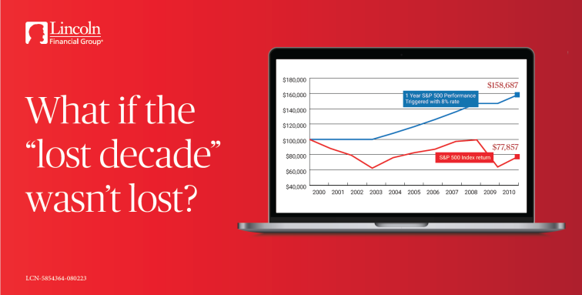
Save image as PDF and link to: https://visit.lfg.com/FA-LOST-FLI001
For financial professional use only. Not for use with the general public.

