Slide 1
Brought to you by Lincoln Advanced Sales Solutions
LIFE SOLUTIONS
10-minute Sales Concept
Taking advantage of market volatility while implementing a wealth transfer strategy
Not a deposit
Not FDIC-insured
May go down in value
Not insured by any federal government agency
Not guaranteed by any bank or savings association
Insurance products issued by:
The Lincoln National Life Insurance Company Lincoln Life & Annuity Company of New York
LCN-4713645-042722
For broker-dealer use only. Not for use with the public.
©2022 Lincoln National Corporation
1

Slide 2
“Never Sell in the Midst of a Panic”
Taking advantage of market dips to implement a wealth transfer strategy can be a good idea.
Notes:
There are times when investing in the stock market has seemed like riding a roller coaster. Down a lot one day, and up even more the next day. Same thing, day after day and week after week. You have heard this before, don’t panic and sell when the markets and asset values are depressed. Traditional investing advice suggests selling low locks in the losses.
This is generally good advice if you are thinking about liquidating a position when the markets are down. However, this advice may not apply to wealth transfer strategies
We may look back in a few months, or even next year, and realize that right now may be the perfect time for ultra-high net worth clients to implement a wealth transfer strategy.
From an estate planning perspective, taking advantage of market dips to implement a wealth transfer strategy can be a good idea. Even a 5% dip can enhance the efficiency of wealth transfer.

Slide 3
Wealth transfer is a long-term strategy
Tax Cuts & Jobs Act sunsets in 2025
Reduction of the lifetime exemption beginning on 1/1/26
Make multiple gifts to an irrevocable grantor trust whenever the stock market has a dip between now and the end of 2025
Notes:
Many ultra-high net worth clients intend to use their lifetime exemption before the end of 2025. The reason for 2025 is the sunset of the Tax Cuts & Jobs Act and with that, the reduction of the lifetime exemption beginning on 1/1/26
One strategy is to make multiple gifts to an irrevocable grantor trust whenever the stock market has a dip between now and the end of 2025. They could decide to take advantage of future market dips to sell securities to an irrevocable grantor trust in exchange for a note. They then could forgive the note before the end of 2025. This would take steady timing…

Slide 4
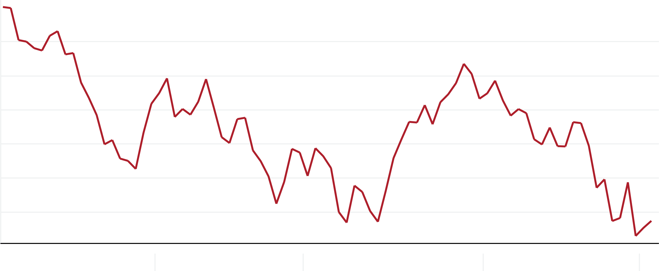
S&P 500 index from January 1, 2022 to March 21, 2022
2022 got off to a volatile start over the first 54 trading days with the S&P index down over 12% at one point, and then recovering to be down a little more than 6%
4,800
4,700
4,600
4,500
4,400
4,300
4,200
Jan 2022
Feb 2022
Mar 2022
Apr 2022
May 2022
Source: https://www.macrotrends.net/2526/sp-500-historical-annual-returns
Notes:
Think about 2022. It got off to a volatile start over the first 54 trading days with the S&P index down over 12% at one point, and then recovering to be down a little more than 6%. Some viewed this as a buying opportunity, some likely panicked and sold positions, others may view it as a wealth transfer opportunity.
Source: https://www.macrotrends.net/2526/sp-500-historical-annual-returns

Slide 5
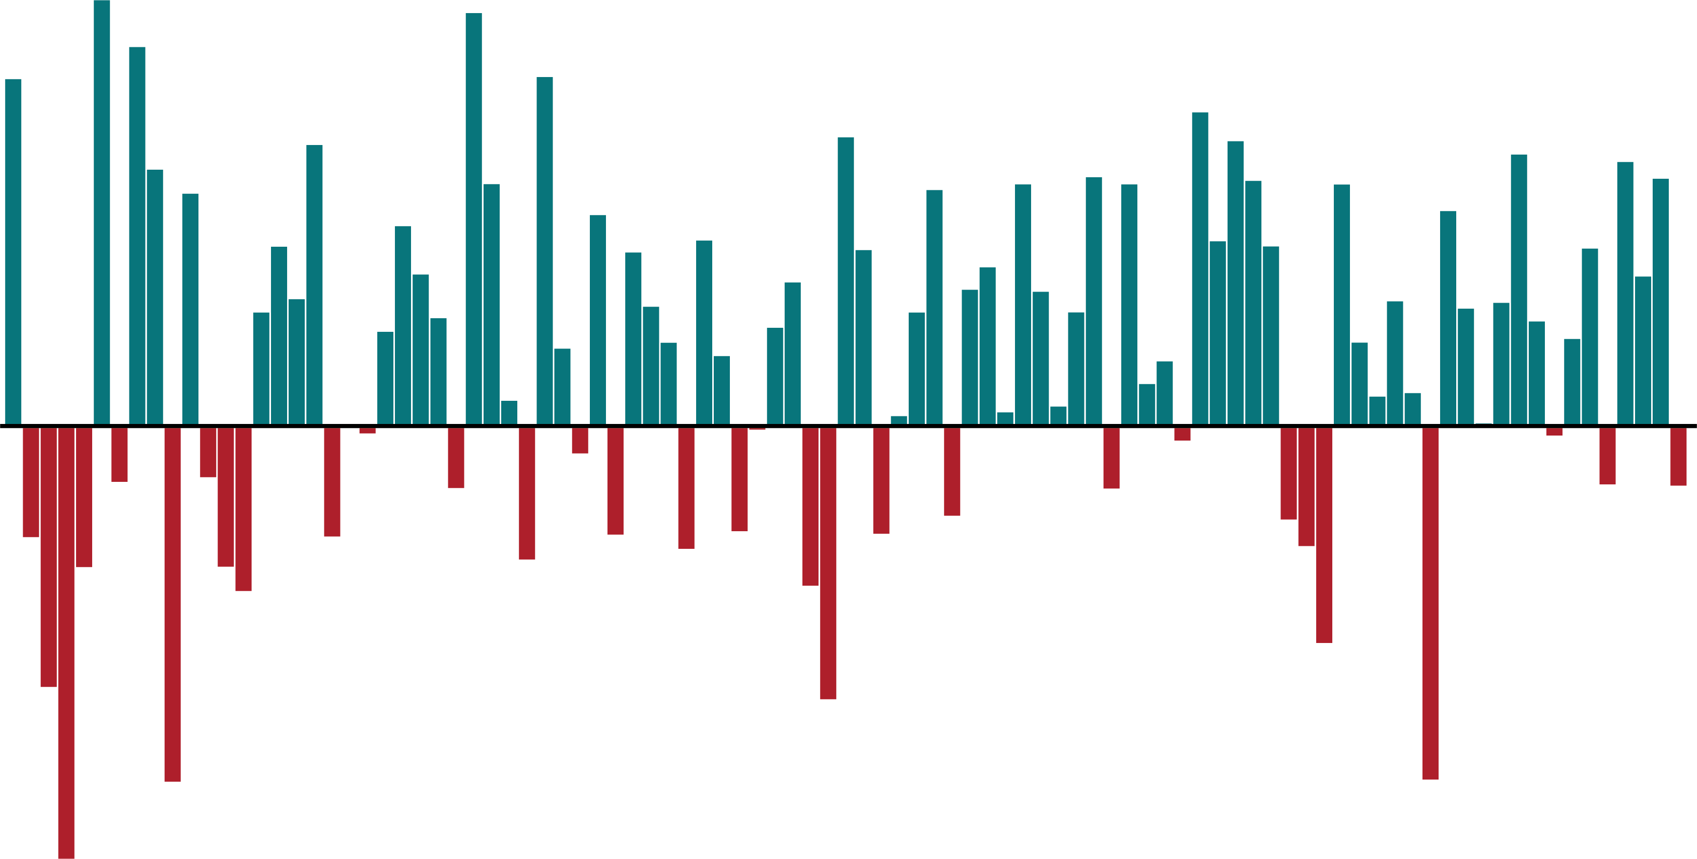
S&P 500 index dating back to 1927
Source: https://www.macrotrends.net/2526/sp-500-historical-annual-returns
50%
40%
30%
20%
10%
0%
-10%
-20%
-30%
-40%
1930
1940
1950
1960
1970
1980
1990
2000
2010
2020
Notes:
If we look back at the historical performance of the S&P 500, dips in the market are often followed by recovery. In other words, do your high net worth clients believe that history repeats itself and that values of currently depressed investment assets will recover?
If yes, then now may be the perfect time for ultra-high net worth clients to implement a wealth transfer strategy by selling their prized investment assets to an irrevocable grantor trust.
Source: https://www.macrotrends.net/2526/sp-500-historical-annual-returns

Slide 6
Case study
Meet Sam, 50 years old, PNT
Case facts
In the last few months, Sam’s $30 million dollar portfolio was reduced to $20 million due to market volatility but has since recovered to about $25 million — he expects the value to continue to recover in the future.
Sold his business last year and is now looking to implement a wealth transfer strategy
Goals
No desire to liquidate his portfolio
Move money out of his estate
Wishes he had acted to implement his wealth transfer when the asset values were only $20 million
Notes:
Let’s look at this through the eyes of a case study. (Review case facts and goals)
Sam sold his business a few years ago and is essentially retired. Going forward, he expects to rely on a large portfolio of equities and short term bonds that were worth over $30 million. Due to an up and down market, those assets dropped as low as $20 million and are worth about $25 million now. He expects those values to continue to improve as the economy recovers. He has been making the maximum annual gifts permitted to his children and grandchildren but has delayed implementing any wealth transfer planning.

Slide 7
Two options
Option 1
Option 2
Gift the portfolio to the trust
Use lifetime exemption
Sell the assets to the trust
Takes back a note for sales price
Notes:
Sam has a couple of options.
The first option is easy to understand. He could create a trust, gift the selected assets from his portfolio to the trust, and use up most of his $12.06 million lifetime exemption. Unless all of the assets being contributed are cash and marketable securities, the grantor may need to obtain appraisals of the fair market value for assets like investment real estate..
By contrast, option 2 is a little more difficult to explain. Ideally, in this approach we want to identify assets that produce a good cash flow each year. Investment real estate is often considered a good choice because the properties may produce up to 7% cash flow each year. This approach allows the grantor to postpone when he has to use his lifetime exemption until closer to December 31, 2025 when the lifetime exemption is scheduled to be cut in half. He could sell the assets to the trust and take back a note for the sales price. It should be noted that most estate planners follow various IRS private letter rulings and loan 90% of the sales price, and gift the remaining 10% (unless the trust already has other assets equal to 10% of the sales price).

Slide 8
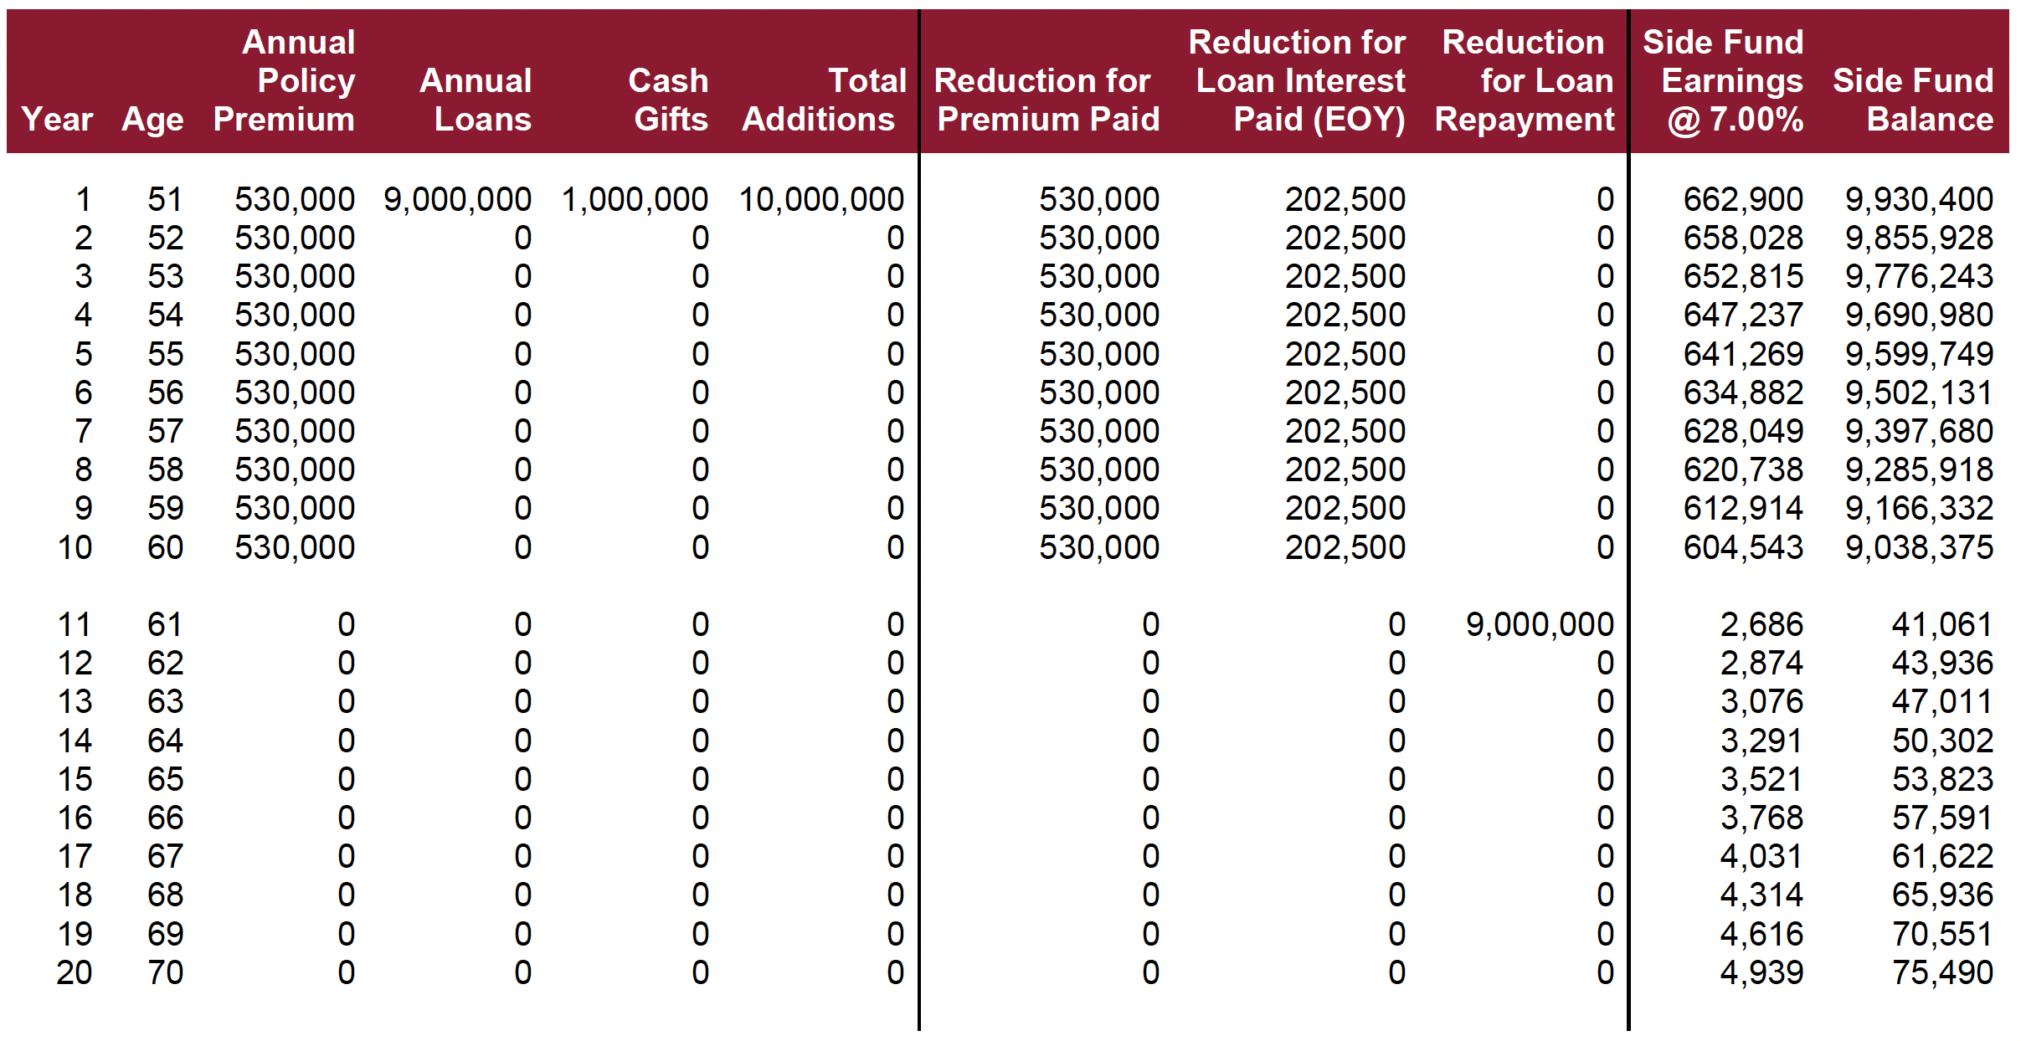
Using a gift to fund life insurance
This is only the private financing ledger at 2.25%
Notes:
This is the financing page showing option 2 from our previous slide. It does not matter what the client’s age might be—but this illustration was for a 50 year old. If the parties lock in the long term AFR for the loan (April 2022 long term rate is 2.25%), the trust grantor generally receives that portion of the cash flow the assets are producing. If the current cash flow of the assets is 7%, then approximately 4.75% of remaining cash flow received by the trust can be used to pay premiums on a trust owned life insurance policy. DesignIt’s private premium financing software can model this approach and include the desired life insurance coverage. Bottom line is that there is about $530,000 of annual cash flow to pay premiums.

Slide 9
Using a guaranteed death benefit
Lincoln VUL^{ONE} (2021)
$530,000
of income
$17,682,358
Lifetime Guaranteed death benefit coverage
VUL^{ONE} policy
The financing assumed a $9 million loan and a $1 million gift. 50-year-old male, preferred non-tobacco. That’s a guaranteed death benefit purchased in a time of market volatility without selling equity positions in a down market.
Notes:
If we take that $530,000 of income and use it to buy life insurance we have the opportunity for instant leverage. How much lifetime guaranteed death benefit coverage can be acquired for ten $530,000 annual premiums using Lincoln’s VULOne? $17,682,358
The financing assumed a $9 million loan and a $1 million gift. 50 year old male, preferred non-tobacco. That’s a guaranteed death benefit purchased in a time of market volatility without selling equity positions in a down market.
Remember, the older, or less healthy the client, the smaller the guaranteed death benefit will be.

Slide 10
How Lincoln provides support
Resources
Advanced Market Resource Center (AMRC)
Lincoln DesignItSM Sales Module
LFG.com/TOLI
Advanced Sales
Notes:
(READ SLIDE)

Slide 11
Summary
Market volatility may present an opportunity to act on market dips to move future appreciation out of the client’s taxable estate.
The sale of assets to an irrevocable grantor trust can be a successful wealth transfer technique.
Cash flow within the trust can be used to fund life insurance.
How many clients do you have who are concerned about taxes at death?
How many clients do you have who have prior planning that may be impacted by the change?
Notes:
We know that the sale of assets to an irrevocable grantor trust can be a successful wealth transfer strategy. Don’t let market volatility cause your clients to do nothing about their estate plan. Point out to them that if they believe the asset values will eventually recover, market dips can be an excellent opportunity to actually implement a wealth transfer strategy such as what we have been talking about. Remember, if a trust has cash flow producing assets, that cash flow can be used to fund life insurance. Focus you attention on those clients who are already concerned about the impact that estate taxes can have on their wealth transfer plans.

Slide 12
Disclosures
[Add more disclosure here. Always keep the paragraph below.]
Lincoln Financial Group is the marketing name for Lincoln National Corporation and its affiliates, including The Lincoln National Life Insurance Company, Fort Wayne, IN, and Lincoln Life & Annuity Company of New York, Syracuse, NY. Variable products distributed by broker-dealer/affiliate Lincoln Financial Distributors, Inc., Radnor, PA. Securities and investment advisory services offered through other affiliates. Affiliates are separately responsible for their own financial and contractual obligations.

Slide 13
Thank You

