Slide 1
10-minute Sales Concept
Brought to you by Lincoln Advanced Sales Solutions
Increasing the Transfer Rate
Using life insurance when transferring an IRA
Not a deposit
Not FDIC-insured
May go down in value
Not insured by any federal government agency
Not guaranteed by any bank or savings association
Insurance products issued by:
The Lincoln National Life Insurance Company
LCN-6055861-102723
For financial professional use only. Not for use with the public.
©2023 Lincoln National Corporation
Notes:
Welcome to a 10-minute sales presentation on Increasing the Transfer Rate by using life insurance. Today, we’ll look at why this planning strategy is important to those with IRA balances in their portfolio.

Slide 2
Qualified plans
Why it matters
Potential employer matches
Tax-deferred growth potential until distribution
Lowers annual taxable income
Notes:
Tax-conscious individuals have often considered qualified plans to be an important part of their preparations for a more comfortable and secure retirement. With that, qualified accounts have become the go-to for retirement planning as pension offerings dwindled. There are numerous advantages to using an account like a 401(k) such as:
Potential employer matches
Tax-deferred growth
Lower taxable income
One of the more common approaches to retirement is to rollover a 401(k) balance into an IRA when an individual retires. In fact, according to statistics, as of 2021, it’s estimated that there were $11.8 trillion in IRA assets in the U.S.
https://www.statista.com/statistics/187894/traditional-ira-total-assets-in-the-us-since-2000/

Slide 3
Tax collector’s “Double Play”
At death, qualified plan assets can be subject to the following taxes:
Estate taxes
The qualified plan's entire fair market value is included in the owner's taxable estate and may be subject to both federal and state estate taxes.
Income taxes
The entire value of the qualified plan is taxable as ordinary income, to either the beneficiary of the qualified plan or to the owner's estate, depending on who receives it.
Notes:
While there are benefits of qualified accounts like a 401(k) or IRA, there can be drawbacks should an individual not use the assets themselves and instead, transfer their IRA at death.
Prior to the SECURE Act, someone who had a balance in a qualified account, like an IRA, may have had enough assets in other accounts that they would “tag” the IRA as an asset to transfer to the next generation. And prior to the Act, they could do so with relative efficiency by using the stretch provision.

Slide 4
Stretch provision
What changed
Pre-SECURE Act
A beneficiary of an IRA could take RMDs based on their life expectancy. This allowed the individual to “stretch” the payments.
SECURE Act
Spousal rollovers still allowed
Majority of beneficiaries must now liquidate account balance by the end of the tenth year
Exceptions, or qualified beneficiaries, still allowed to stretch:
Surviving spouse
Disabled or chronically ill individuals
Individuals who are not more than 10 years younger than the account owner, or
Child of the account owner who has not reached the age of majority
Notes:
Under prior law, a beneficiary who inherited an IRA from a deceased owner had several options for taking distributions from the IRA, including the ability to take distributions over his or her life expectancy determined at the death of the owner, AKA “stretch” the distributions. If the beneficiary elected to take life expectancy distributions, RMDs would be distributed each year with the balance left to grow tax-deferred in the IRA until the next one and so on.
Generally speaking, spousal rollovers are the most common form of transfer and those spousal rollovers are still available to utilize the stretch provision. However, should the account holder pass the IRA to the next generation, for example adult children, the beneficiary would now need to liquidate the account by the end of the tenth year. This brings a change to a long-standing planning technique. Instead of spreading out distributions, which in turn allows more years for potential growth and a spread tax burden, many beneficiaries could face an unwanted, or perhaps unknown, tax bill.
Life insurance can play an important role in addressing the transfer tax issues associated with passing a qualified asset from generation one to generation two in many scenarios. With the added layer of removing the stretch provision, the role of life insurance is magnified.

Slide 5
Transfer rate
The impact
Decrease in potential growth of retirement assets transferred to a nonspouse beneficiary.
Distributions are higher over a shorter period of time, likely resulting in higher income taxes to the beneficiary.
Less time for potential growth, higher distributions and higher taxes will result in a lower amount transferred to heirs.
Growth
Income tax
Net assets to heirs
Notes:
Since qualified plans or retirement plan assets are not taxable until distributed, the stretch provision preserved the tax-deferred status of an inherited account for nonspouse beneficiaries. The stretch provision generally yielded lower required distributions, and therefore, a lower annual tax liability associated with those distributions. The funds that remained in the IRA would continue to receive tax-deferral and potential growth for decades.
With the SECURE Act and the 10-year rule, a majority of beneficiaries now have less years for growth, which compresses (or increases) the income tax payments, and results in a lesser amount the next generation has available. As mentioned on the prior slide, life insurance is an ideal product to offset the assets lost to taxes at transfer.

Slide 6
Case study
How life insurance fits
Matt, male, age 73, Preferred |  | Jessica, female, age 71, Preferred |  | $1M Lincoln WealthPreserve® SIUL
Case facts
IRA value of $1M with assumed 5% ROR that they do not need for retirement
IRA owner combined federal and state income tax rate 40%
Goals
Pass IRA to adult child, Tony
Beneficiary combined tax rate of 40%
Plan in action
Insurance funded via withdrawals from IRA
$1M death benefit — Scheduled premiums paid to maturity
Spousal transfer at IRA owner’s death, age his 90
Nonspousal transfer at spouse’s death to adult child at her age 90
Notes:
Let’s see this through the eyes of a case study … (READ CASE FACTS AND GOALS)
Matt and Jessica know that Matt must take RMDs even though they are currently drawing a comfortable income from their other assets. Their financial professional suggests using those distributions from the IRA and redirecting them as a way to fund life insurance. In doing so, they can address the taxes due at transfer to their adult son, Tony.
In our scenario, we’ll assume Jessica inherits the IRA at Matt’s death, the IRA then transfers to Tony at Jessica’s death, and we’ll use a Lincoln WealthPreserve® SIUL. Because spousal rollovers are still allowed under the SECURE Act, using a second to die policy provides a higher death benefit for their son while not paying out until the time of a generational transfer. Plus, should the policy experience a level of positive returns, there is potential upside while guaranteeing the death benefit.
Speaker note — Insurance premiums are funded from withdrawals from the IRA. Any withdrawals in excess of what is needed to pay premiums such as RMDs are considered to be consumed by the IRA owner. The IRA owner could choose to reinvest excess after-tax RMDs or gift those assets to his or her heirs, which only increases the amount transferred. Any excess RMDs are not accounted for in this analysis, but only increases the net amount transferred.

Slide 7
Case study
How life insurance fits
Matt, male, age 73, Preferred |  | Jessica, female, age 71, Preferred |  | $1M Lincoln WealthPreserve® SIUL
IRA balance at time of transfer
Ten annual distributions of $103,009 x 10 years =
Federal income tax $36,053 x 10 years =
State income tax $5,150 x 10 years =
Cumulative total after tax =
$795,411
$1,030,090
$360,530
$51,500
$618,054
Note: A fixed income tax rate is assumed for illustration purposes. The actual effective tax rate will be lower since income falls into different brackets and is taxed at different rates.
Notes:
What happens at the time of that transfer from Jessica to Tony? Remember that he must liquidate the balance by the end of the tenth year, so for our example, we’ll assume he takes annual distributions for 10 years.
Here you can see that assuming a 5% growth rate and RMDs being taken out until the time of transfer to generation two, the IRA would have a value of $795,411. When we take into account the 10-year rule that Tony must adhere to, he would take a pretax distribution of $103,009 annually. Factor in the state and federal income taxes due with each distribution and Tony would net $61,805 annually.
Over the course of 10 years, Tony will have paid $412,030 in cumulative taxes while netting $618,054 in distributions.

Slide 8
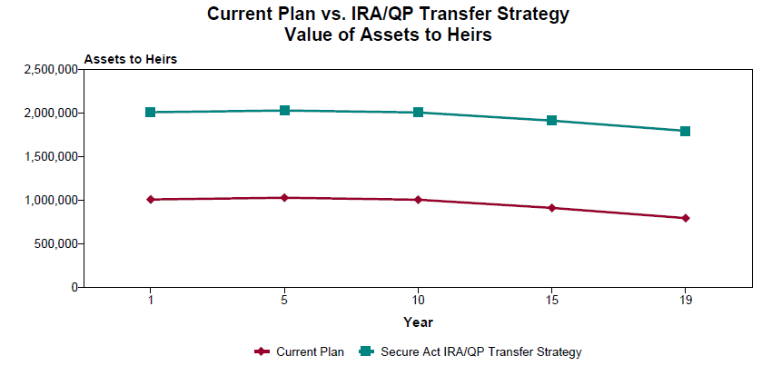
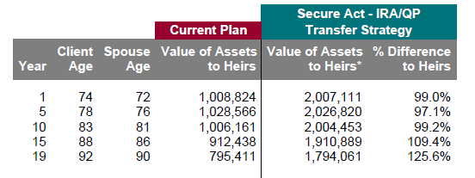
Case study
How life insurance fits
Notes:
If Matt and Jessica make the decision to leverage Matt’s IRA and use it to fund life insurance, they can increase the total amount being transferred. The addition of life insurance instantly increases the total amount being transferred. This graph and ledger compares the current IRA with the strategy of purchasing $1M of life insurance and reflects the amount transferred to the nonspousal heirs. As you can see here, the green line represents the plan inclusive of life insurance. The red, without. From year one and beyond, the transfer amount from generation one to generation two is higher with the inclusion of life insurance.

Slide 9
Case study
How life insurance fits
Matt, male, age 73, Preferred |  | Jessica, female, age 71, Preferred |  | $1M Lincoln WealthPreserve® SIUL
IRA balance at time of transfer
Ten annual distributions of $102,834 x 10 years =
Fed $35,992 x 10 years =
State $5,142 x 10 years =
Life insurance death benefit =
Cumulative total after tax =
$795,061
$1,028,340
$359,920
$51,420
$1,000,000
$1,960,920
Note: A fixed income tax rate is assumed for illustration purposes. The actual effective tax rate will be lower since income falls into different brackets and is taxed at different rates.
Notes:
Now that we’ve seen life insurance add leverage from day one, let’s see what the numbers look like. Recall that if Matt and Jessica stick with their current plan, Tony would have a gross distribution of $103,009 annually.
Here we see that the gross annual distribution has decreased to $102,834. However, the addition of life insurance increases the total amount after tax that Tony receives from $618,054 to $1,960,920. This assumes the death benefit was received and then invested in a taxable account earning 5%.
*Speakers note — distribution reduction is due to premiums being paid out of the IRA balance.

Slide 10
Transfer rate
How life insurance fits
IRA balance at time of transfer
Ten annual distributions of $103,009 x 10 years =
Fed $36,053 x 10 years =
State $5,150 x 10 years =
Cumulative total after tax =
$795,411
$1,030,090
$360,530
$51,500
$618,054
Net transfer rate
60%
IRA balance at time of transfer
Ten annual distributions of $102,834 x years =
Fed $35,992 x 10 years =
State $5,142 x 10 years =
Life insurance death benefit =
Cumulative total after tax =
$794,061
$1,028,340
$359,020
$51,420
$1,000,000
$1,960,920
Net transfer rate
83%
Note: A fixed income tax rate is assumed for illustration purposes. The actual effective tax rate will be lower since income falls into different brackets and is taxed at different rates.
Notes:
If we look at the two scenarios together with the bottom pie chart showing the impact of purchasing $1,000,000 of life insurance, the strategy becomes even clearer.
The addition of life insurance, even with the premiums that were paid, increases our total transfer rate. In other words, instead of <CLICK> transferring 60% of the gross assets, we instead <CLICK> have 83% of the total assets being transferred. Keep in mind this was done using an asset, an IRA, that Matt and Jessica had planned on passing down anyway, which means there wasn’t a decrease in planned income for them while funding.

Slide 11
How many clients do you have with IRA balances who ...
Have excess qualified assets not needed for their own income
Have a desire to leave a legacy to the next generation
Express concern about transfer taxes at death
Have done prior trust planning for the purposes of asset transfer
Notes:
(READ SLIDE)

Slide 12
How Lincoln provides support
Resources
Advanced Market Resource Center (AMRC)
Click here to start exploring with this how-to access guide
Lincoln DesignItSM Sales Module
Reinvestment of excess RMDs not available
SECURE Act white paper
Advanced Sales Team
AdvancedSales@LFG.com
800-832-5372
Notes:
(READ SLIDE)

Slide 13
Summary
SECURE Act was written to encourage retirement planning
The elimination of the stretch provision alters how much heirs receive when inheriting an IRA
Life insurance can be a tool to deploy to help offset taxes and increase transfer rates
How many clients do you have who are concerned about taxes at death?
How many clients do you have who have significant Qualified Plan Assets?
How many clients do you have who have prior planning that may be impacted by the change?
Notes:
(REVIEW SLIDE)

Slide 14
Important information
Issuers: The Lincoln National Life Insurance Company, Fort Wayne, IN The Lincoln National Life Insurance Company does not solicit business in the state of New York, nor is it authorized to do so.
All guarantees and benefits of the insurance policy are subject to the claims-paying ability of the issuing insurance company. They are not backed by the broker-dealer and/or insurance agency selling the policy, or any affiliates of those entities other than the issuing company affiliates, and none makes any representations or guarantees regarding the claims-paying ability of the issuer.
In some states, contract terms are set out and coverage may be provided in the form of certificates issued under a group policy issued by The Lincoln National Life Insurance Company to a group life insurance trust. Products, riders and features are subject to state availability. The insurance policy and riders have limitations, exclusions, and/or reductions. Check state availability.
Lincoln Financial Group® affiliates, their distributors, and their respective employees, representatives, and/or insurance agents do not provide tax, accounting, or legal advice. Please consult an independent professional as to any tax, accounting, or legal statements made herein.
Distributor: Lincoln Financial Distributors, Inc., a broker-dealer
Policies: Lincoln WealthPreserve® 2 Survivorship IUL (2022) policy form ICC22-SUL6094/ 22-SUL6094 and state variations.
Lincoln Financial Group® affiliates, their distributors, and their respective employees, representatives and/or insurance agents do not provide tax, accounting or legal advice. Please consult an independent advisor as to any tax, accounting or legal statements made herein.

Slide 15
Thank you.

