Slide 1
PolicyHub Overview
May 10, 2023
Notes:
11

Slide 2
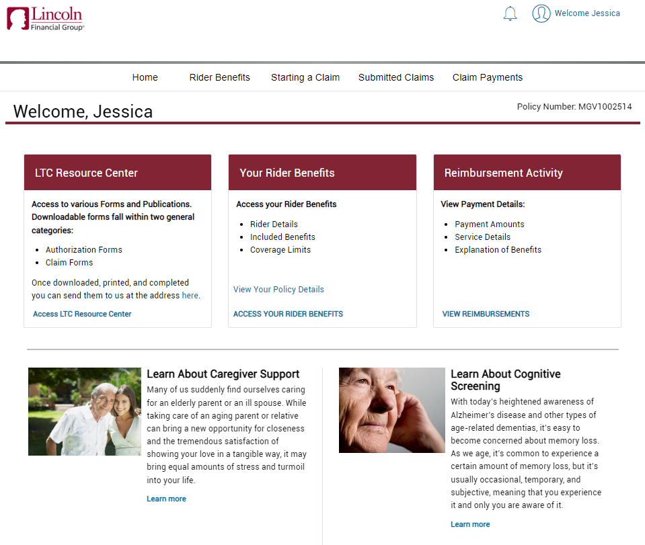
Homepage
There are three quick access links to the most frequently used locations in the portal, including the LTC Resource Center, which contain many commonly used forms that are available for download.
Flex spaces are chosen by the carrier and can be customized with articles, current events, announcements, videos, etc.

Slide 3
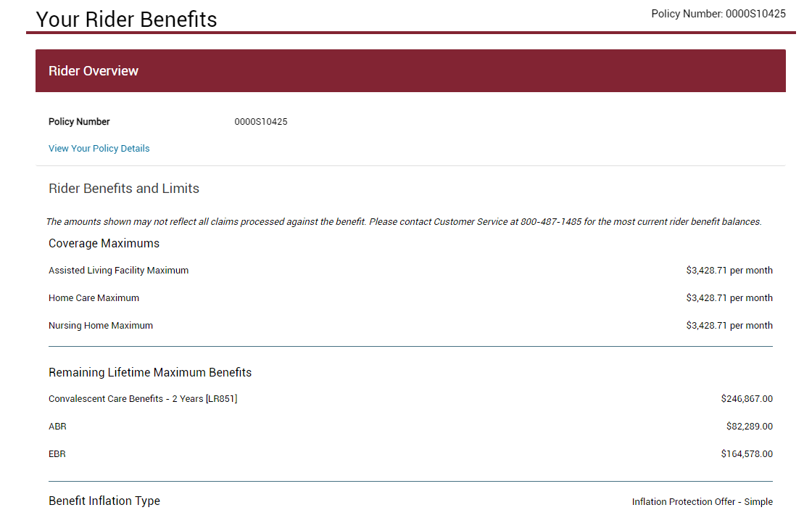
Policy and benefits
View policy benefits and coverages:
Benefit maximums
Policy features
Link takes user back to LincolnFinancial.com

Slide 4
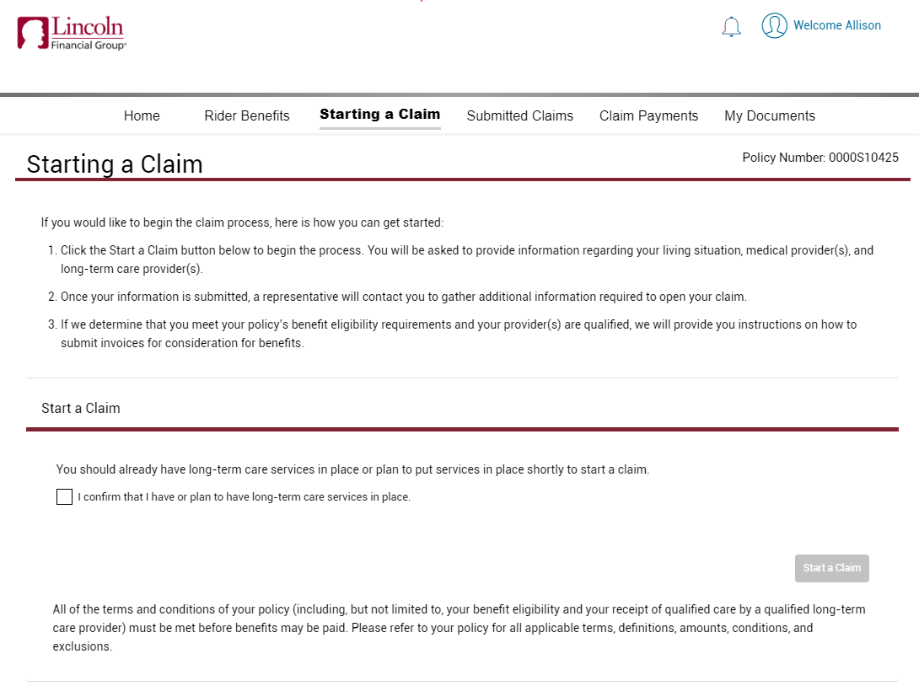
Starting a Claim

Slide 5
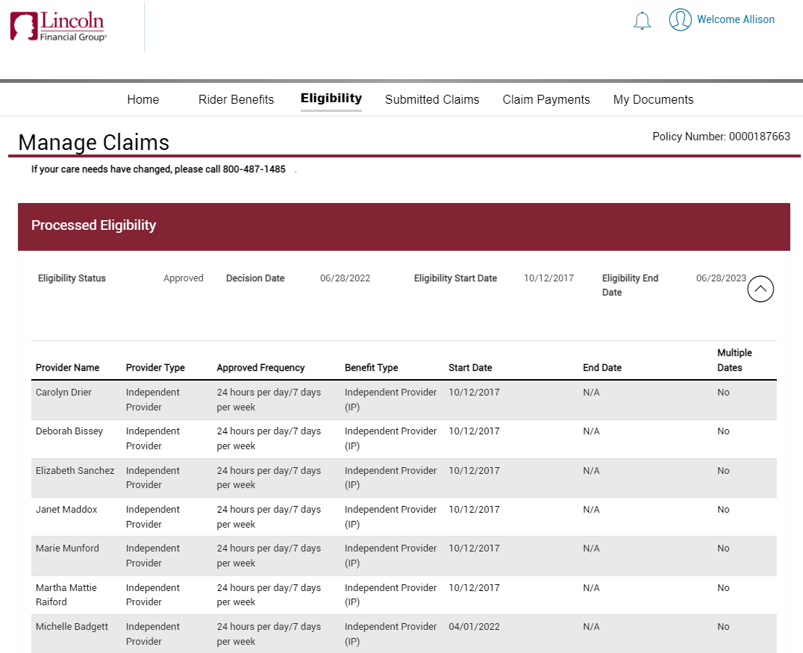
Eligibility – currently on claim
View processed benefit eligibility:
Dates of eligibility
Approved providers
Approved benefits
This page also shows any previously approved benefit eligibility information.

Slide 6
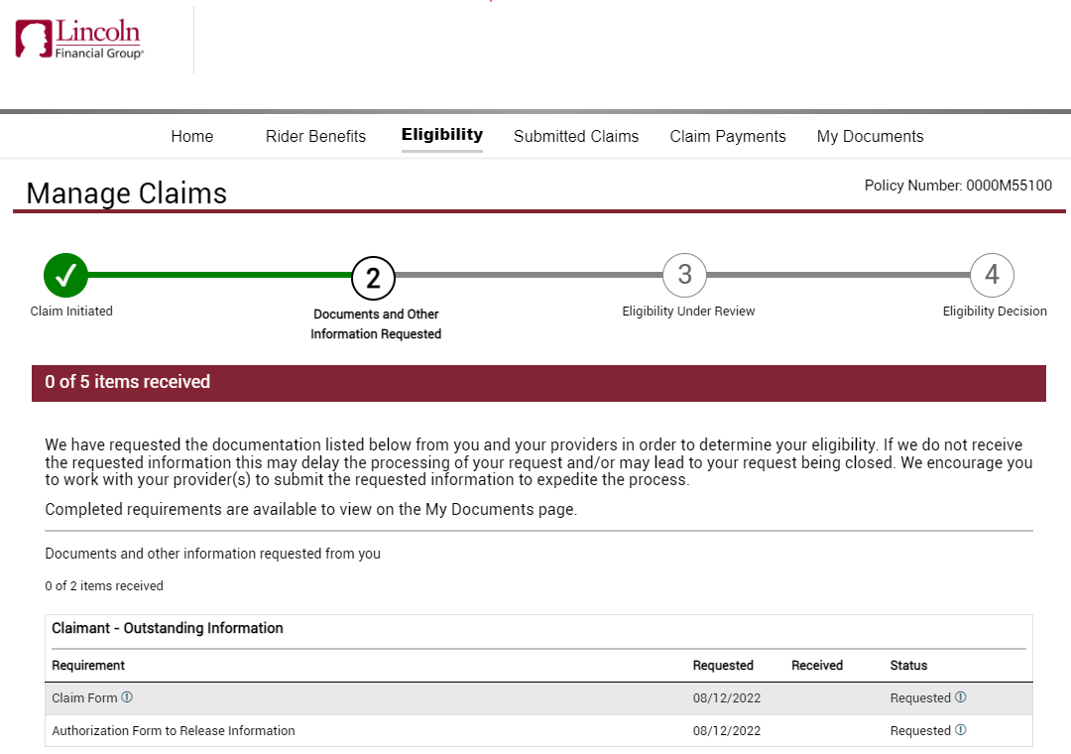
Eligibility – pending claim
Access current status of claim:
Initiated
Requirements ordered
Requirements received/pending decision
Eligibility decision completed

Slide 7
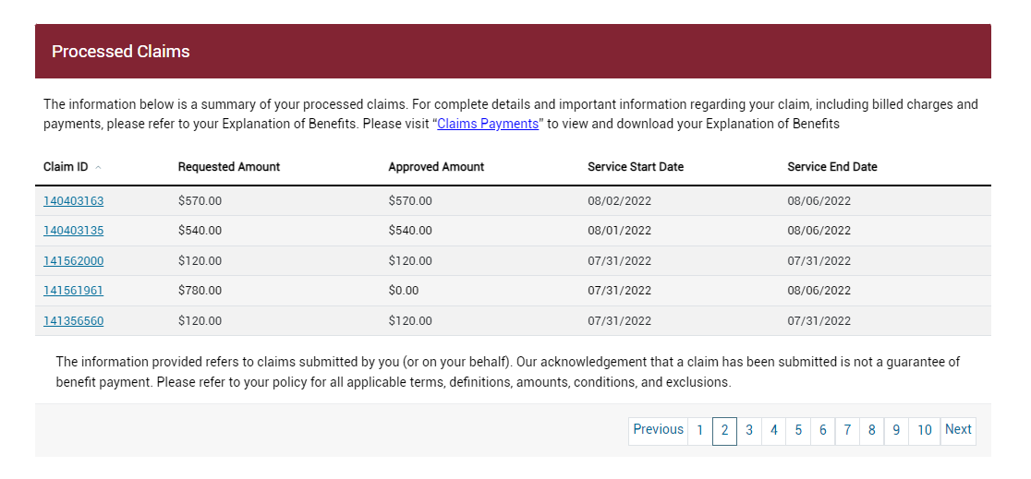
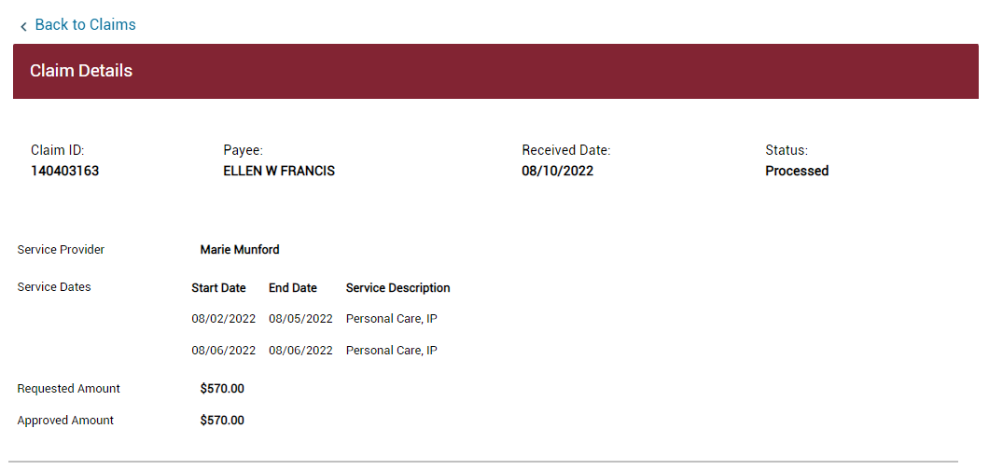
Submitted claims
Claim ID link directs the user to the Claim Details screen.

Slide 8
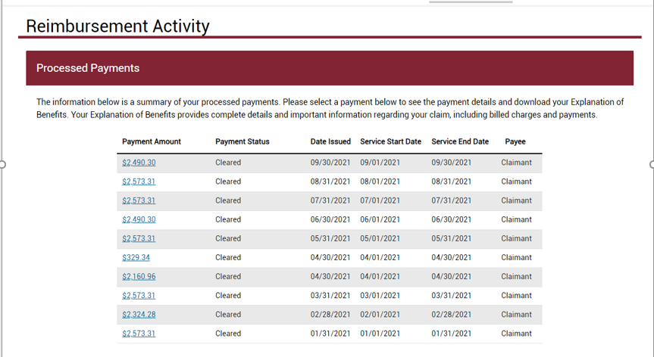
Claim payments
Access claim payment details and download Explanation of Benefits.

Slide 9
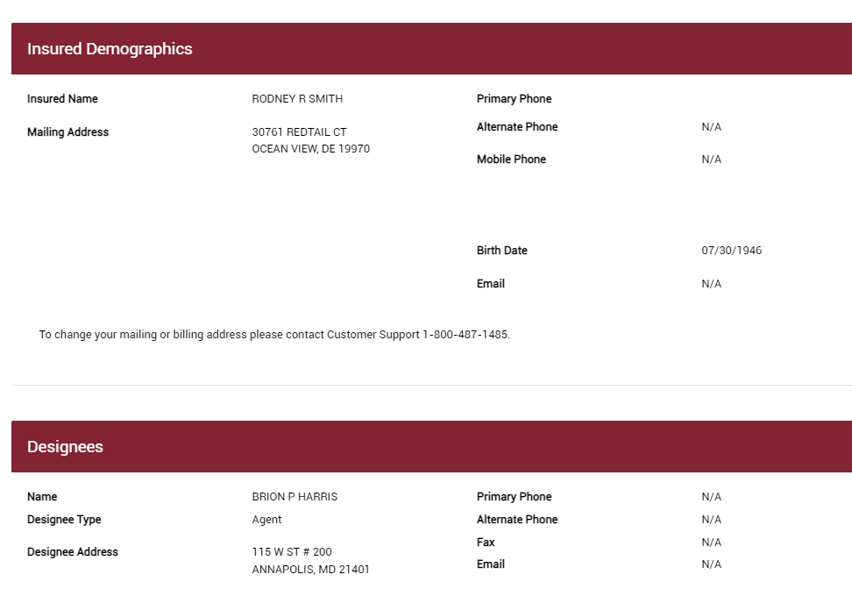
Policyholder profile
Demographics:
List of Designees
Optional to allow edits to Demographics

Slide 10
My Documents

Slide 11
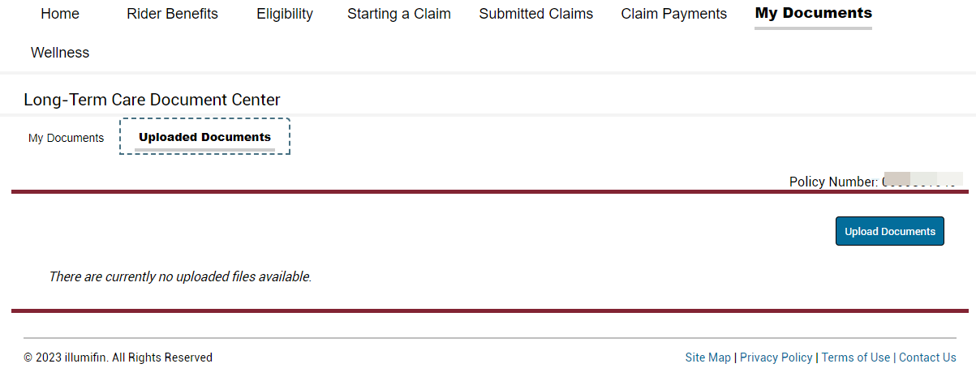
My Documents – upload functionality

Slide 12
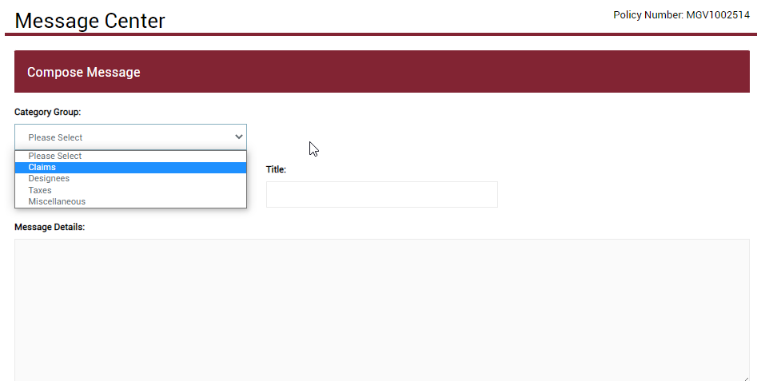
Policyholder profile – Message Center
Send email messages directly to the Customer Service team through the
Message Center.
Order code: MG-LTCG-PPT001
5/23 Z02

