Slide 1
Help female clients face the future with confidence
LONG-TERM CARE PLANNING
Women & LTC
Not a deposit
Not FDIC-insured
May go down in value
Not insured by any federal government agency
Not guaranteed by any bank or savings association
Insurance products issued by:
The Lincoln National Life Insurance Company
Lincoln Life & Annuity Company of New York
LCN-3007054-032320
For financial professional use only. Not for use with the public.
©2020 Lincoln National Corporation
1

Slide 2
Agenda
Women and LTC
Proactive planning
Understanding LTC
Family focus
Cost of care
Embracing their future
Notes:
We’ll review:
<CLICK> Women and LTC
<CLICK> Proactive planning
<CLICK> Understanding LTC
<CLICK> Family focus
<CLICK> Cost of care
<CLICK> Embracing their future

Slide 3
Women & LTC
Notes:
Let’s look at the unique situations women may face when it comes to LTC.

Slide 4
Female-focused conversations
Talking about LTC is important for all of your clients, but because of increased risk for women, it’s even more critical for your female clients. Yet research shows a planning gap in the marketplace for women and LTC planning. Change this by initiating LTC planning conversations with your female clients.
Over 50% of women will need LTC in their lives.¹
¹ Lananh Nguyen and Bloomberg, “U.S. Women Control $14 Trillion — but Most Wealth Managers Still Ignore Them,” fortune.com,
April 11, 2019, https://fortune.com/2019/04/11/women-money-assets-wealth-management-financial-advisers/.
Notes:
<Read slide> <CLICK><CLICK>

Slide 5
Life expectancy risk
A 65-year-old woman in “average” health has a great chance of living a long life.¹
of women need long-term care services at some point in their lives.²
Nearly an 80% chance of living to 80. ¹
50/50 chance of living to 90. ¹
10% chance of living to 100. ¹
¹Sponsored by American Academy of Actuaries and Society of Actuaries, “Actuaries Longevity Illustrator,” www.longevityillustrator.org, July 11, 2019.
²https://www.healthinaging.org/age-friendly-healthcare-you/care-settings/nursing-homes.
Notes:
By nature, women tend to outlive men. <CLICK> The numbers here tell a great story. <Read slide> <CLICK><CLICK> <CLICK> <CLICK>

Slide 6
Gender risk
Gender-biased expectations about caregiving
Women need care longer than men
43.9%
Americans have provided unpaid care to an adult.¹
60% of the time, the caregiver was a woman.¹
Women typically need long-term care services for 1.5 years longer than men. ²
¹National Alliance for Caregiving and AARP, “2015 Report: Caregiving in the U.S.,” http://www.caregiving.org/wp-content/uploads/2015/05/ 2015_CaregivingintheUS_Final-Report-June-4_WEB.pdf, June 2015. *This study is conducted every five years on average. The 2020 report will be available in 2020.
²U.S. Department of Health and Human Services, “How Much Care Will You Need,” LongTermCare.gov, https://longtermcare.acl.gov/the-basics/how-much-care-will-you-need.html, July 11, 2019.
Notes:
When it comes to providing care, women are also more at risk than men. And it’s difficult—if not impossible—to predict when someone may need long-term care. <CLICK> Unfortunately, statistics show that the wives, daughters, sisters and mothers in the family are most often the ones who carry the burden of caregiving. <Read stats.> <CLICK>
¹National Alliance for Caregiving and AARP, “2015 Report: Caregiving in the U.S.,” http://www.caregiving.org/wp-content/uploads/2015/05/ 2015_CaregivingintheUS_Final-Report-June-4_WEB.pdf, June 2015. *This study is conducted every five years on average. The 2020 report will be available in 2020.

Slide 7
Proactive planning
Notes:
Let’s go through some ways you can start a conversation with your female clients that can help them focus on proactive planning.

Slide 8
Conversation starter
Share your thoughts with me about long-term care.
Notes:
<Read slide>

Slide 9
Clients have misconceptions about LTC, such as:
1
2
3
4
“It won’t happen to me.”
“Medicare and Medicaid have me covered.”
“That’s what my savings are for.”
“My family will be able to take care of me.”
With retirees living longer than ever before, the need for a long-term care solution becomes more a "when" than an "if" situation.¹
Medicare pays only a portion of costs up to 100 days. And Medicaid is only available to those with
limited assets and income.
72% of those surveyed worry that they would not be able to provide adequate care if somebody in their family needed it. ³
The national average cost is greater than $105,000 per year.²
¹ Source: United States Census Bureau, “Living Longer: Historical and Projected Gains to Life Expectancy, 1960-2060,” April, 2019, https://www.census.gov/content/dam/Census/library/ working- papers/2019/demo/paa19_medina_sabo.pdf. 2019; https://www.census.gov/content/dam/Census/library/working-papers/2019/demo/paa19_medina_sabo.pdf. ² LTCG, “2018 Lincoln Financial Cost of Care Survey," March 2019, https://www.whatcarecosts.com/lincoln.For a printed copy, call 877-ASK-LINCOLN.
³ Versta Research, “2017 LTC Marketing and Thought Leadership Research, Findings from Surveys of Advisors and Consumers, http://newsroom.lfg.com/sites/lfg.newshq.businesswire.com/files/doc_library/file/Lincoln_LTC_Study_Part_1_Final_02.21.18.pdf, October 2017.
Notes:
One of the greatest trends that I’ve seen during my time in this industry is a general confusion about long-term care. That is why I’m so passionate about education and awareness. Those two things can help us all plan and better prepare. The biggest planning opportunities we need to pay attention to can be categorized by these common myths.
The first long-term care belief I commonly hear about is: It won’t happen to me. <CLICK> The reality is that total life expectancy has increased by nine years and is projected to increase another seven years. This makes LTC more of a “when” as opposed to an “if”.¹
The second belief: Medicare and Medicaid have me covered. <CLICK> Many people are surprised to hear Medicare only covers a portion of skilled nursing costs up to 100 days. And Medicaid is only available to those with limited assets and income.¹
The third LTC belief: That’s what my savings are for. <CLICK> It’s a sobering reality that currently, the national average cost for a private room in a licensed nursing facility is over $105,000 per year.²
And lastly: My family will be able to take care of me. <CLICK> Our research shows nearly 2/3 of consumers have no plan for long-term care. This could lead to family members needing to step up and play the role of caregiver. Studies have shown women are more often than men the ones doing this. So it’s important women address long-term care planning with their family so it’s not assumed they take on this role.³

Slide 10
Conversation starter
Who do you think needs a long-term care plan?
Notes:
<Read slide>

Slide 11
Everyone needs an LTC plan in place, including:
1
2
3
Young professionals
Pre-retirees
Retirees
May have some excess income to invest after maxing out retirement saving vehicles and may worry about caring for a parent as they age.
May be on track with retirement, but don’t have designated LTC funds and wouldn’t want their children to become their caregivers.
May be financially comfortable in retirement, be able to reposition assets and are focusing on passing wealth along to future generations.
Notes:
<CLICK> <CLICK> <CLICK>

Slide 12
Conversation starter
Should you need care, where would that funding come from?
Notes:
<Read slide>

Slide 13
Your client’s retirement plans can easily be disrupted by a long-term care event.
To help her avoid this:
Let her know that it’s better to plan sooner for long-term care.
Remind her that
Lincoln Financial works with clients ages 30–80 on
LTC planning.
Go over funding options for care down the road.
Notes:
<Read slide>
<CLICK>
<CLICK>
<CLICK>

Slide 14
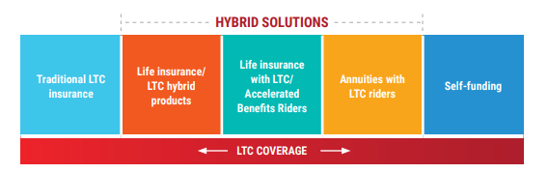
LTC funding options
Notes:
Now, let’s review some long-term care planning options.

Slide 15
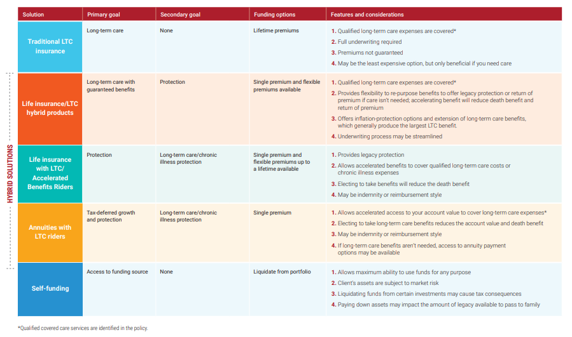
Planning for care
Notes:
This chart summarizes the solutions available and the relative strengths of each option using four key benefits:
Legacy protection, Flexibility, Leverage and Long-term care expense coverage.
Starting with Traditional long-term care insurance. If you just want a policy that covers long-term care expenses, this may be an option. Premiums are paid on a continual basis, and are generally less cash flow-intensive versus newer hybrid life products. Traditional long-term care insurance helps cover out-of-pocket expenses for a variety of services, such as nursing home care, in-home care, assisted living and adult day care. If however, you never need care, you won’t receive any benefits or return of premium.
Lifetime annuity with LTC-related rider. This is an option to consider if your primary goal is securing retirement income, and you want protection from long-term care expenses. As a long-term investment vehicle designed for retirement purposes, an annuity provides a stream of income for as long as you live. The long-term care rider provides additional income should you need care, but the long-term care benefit may be restricted to nursing home care.
Life insurance with accelerated benefit rider. If your primary goal is legacy protection and you want added chronic illness protection, life insurance with an accelerated benefits rider may be an option. It combines death benefit protection with a living benefit. So if you were to develop a permanent chronic or terminal illness, the death benefit is accelerated so that you receive income tax-free funds to pay for expenses or to use for whatever purpose you want.
Life insurance/long-term care combination products are designed to offer more than long-term care protection. For example, a hybrid life/long-term care solution may offer a choice of a death benefit, cash value growth or return of premium, or a combination of those benefits. These benefits can be appealing to individuals who see traditional long-term care policies as a “use it or lose it” proposition. Because if you never need the long-term care benefit, the policy may provide a death benefit or the financial flexibility of return of premium options. Even though these hybrids may cost more than traditional LTC insurance, they feature flexible premium designs that enable you to pay a single premium or spread your premiums over a number of years, which could make paying for protection more affordable.
Self-funding. Some individuals want to maintain asset control by paying for expenses out-of-pocket. But most people are not financially or emotionally prepared to manage a long-term care event and the high costs that accompany it. A long-term care event, even if it lasts just one to two years, can be emotionally demanding and drain cash reserves very quickly without planning. And the unpredictable nature of long-term care makes planning for out-of-pocket payments extremely challenging.

Slide 16
Understanding LTC
Notes:
Now, we’ll look at some ways you can start a conversation with your female clients to ensure they understand LTC and the different care options available to them.

Slide 17
Conversation starter
Have you had any personal experiences as a caregiver?
Notes:
<Read slide>

Slide 18
Allowing your client to share her personal stories can illustrate:
How women are more at risk than men to become caregivers
The effect that caregiving can have on loved ones
The need for a caregiver alternative/ care manager
Only 30% of caregivers felt very prepared when they took on their role as caregiver.*
*Lincoln Financial Group: Caregiving Research, March 2019.
Notes:
<Read slide> <CLICK> <CLICK> <CLICK> <CLICK>

Slide 19
Conversation starter
Are you familiar with different care environments and services provided during an LTC event?
Notes:
<Read slide>

Slide 20
Show her that LTC is more than a nursing home
In-home care:
If you prefer to have assistance
in your home
Assisted living:
If you choose to downsize and
prefer a social atmosphere
Alternative care services:²
If you only need informal care or
if care options evolve
Transitional care:
Lets you access funds to help you
smoothly transition from informal to
formal care
Caregiver training and care planning services:
Lets you further customize your plan
Nursing home:
If you need more skilled care services
Additional care options include non-continuous services, respite care, memory care
facilities, adult day care, hospice and bed reservation.
¹Qualified long-term care services that are not covered under any other provision, but are prescribed in the care plan that a licensed health care practitioner and Lincoln mutually agree are appropriate to meet the insured’s long-term care needs, could be considered for reimbursement. These services must be provided as an alternative to services otherwise covered.
Notes:
<Read slide>

Slide 21
Conversation starter
How do you think an LTC event would impact your family?
Notes:
<Read slide>

Slide 22
Without a plan in place, an LTC event can take a toll on a family:
Emotionally
Financially
Physically
Administratively
Providing care is a more demanding experience than most anticipate.
Source: Lincoln Financial Group: Caregiving Research, March 2019.
Notes:
<Read slide> <CLICK> <CLICK> <CLICK> <CLICK> <CLICK>

Slide 23
Family focus
Notes:
Getting your female clients’ families involved sooner in LTC planning discussions is always better. Here are some ways to prompt those discussions.

Slide 24
Conversation starter
Tell me about your parents and their health.
Notes:
<Read slide>

Slide 25
By listening to her talk about her parents, you can learn about:
Longevity and risk in her family
The type of care she may need
How her parents’ LTC needs were addressed
of nursing home residents are women.¹
¹ https://www.healthinaging.org/age-friendly-healthcare-you/care-settings/nursing-homes.
Notes:
<Read slide>
<CLICK>
<CLICK>
<CLICK>
<CLICK>

Slide 26
Conversation starter
Who would you trust to make care decisions and advocate for your needs?
Notes:
<Read slide>

Slide 27
Creating a care circle for your client’s LTC needs can:
Keep loved ones and caregivers informed and connected
Ensure quick communication across the social network
Offer reassurance to your client since they’ll know their plans are formalized
Remind your clients that long-term care events happen to a family, not just a person.
Notes:
<Read slide> <CLICK> <CLICK> <CLICK> <CLICK>

Slide 28
Conversation starter
Let’s plan a family discussion to go over your LTC plans.
Notes:
<Read slide>

Slide 29
Many clients want to protect their legacy.
They can do this by:
Allocating money for their LTC, should they need it.
Choosing an LTC solution that offers a legacy option.
Notes:
<Read slide> <CLICK> <CLICK>

Slide 30
Cost of care
Notes:
So, let’s look at some ways we can initiate conversations to show your female clients how to plan financially for their future.

Slide 31
Conversation starter
Are you aware of the costs of long-term care?
Notes:
<Read slide>

Slide 32
Americans underestimate the cost of LTC services by half.
By visiting whatcarecosts.com, your clients can compare costs by:
1 LTCG, “2019 Lincoln Financial Cost of Care Survey," March 2020, https://www.whatcarecosts.com/lincoln. For a printed copy, call 877-ASK-LINCOLN.
Notes:
<Read slide> <CLICK> <CLICK>

Slide 33
Conversation starter
Let’s look at funding options for your LTC plan.
Notes:
<Read slide>

Slide 34
A hybrid long-term care solution can help your clients:
Identify sources from assets or income to pay for the plan
Create a tax-efficient funding source for long-term care expenses
Protect their retirement dollars and legacy from the unexpected
Explore flexible payment options, including one-time and monthly payments
Notes:
<Read slide> <CLICK> <CLICK> <CLICK> <CLICK>

Slide 35
Embracing their future
Notes:
You can help your female clients embrace their future with confidence.

Slide 36
What can you do to help clients prepare?
Focus on your female clients who are more at risk than men of needing care or becoming caregivers.
Help them plan ahead to protect their portfolio, their independence and their loved ones.
Set up family meetings to go over legacy planning and care circles.
Notes:
<Read slide> <CLICK> <CLICK> <CLICK>

Slide 37
Questions?
Notes:
Does anyone have questions or some insight they’d like to share?

Slide 38
Thank you.

Slide 39
Disclosures
Affiliates include broker-dealer/distributor Lincoln Financial Distributors, Inc., Radnor, PA, and insurance company affiliates The Lincoln National Life Insurance Company, Fort Wayne, IN, and Lincoln Life & Annuity Company of New York, Syracuse, NY.
This material is provided by The Lincoln National Life Insurance Company and Lincoln Life & Annuity Company of New York, which issue the insurance products described in this material. This material is intended for general use with the public. Lincoln insurers are not providing investment advice for any individual or any individual situation, and you should not look to this material for any investment advice. Lincoln insurers, as well as certain affiliated companies, have financial interests that are served by the sale of Lincoln insurance products. Ask your financial professional for assistance with your situation.
Policies: Lincoln Concierge Care Coordination includes claims support provided by Lincoln Financial and services provided by a third-party vendor not affiliated with Lincoln Financial. Concierge Care third-party vendors do not provide direct care or home services. Results and outcomes cannot be guaranteed. The availability of any particular provider cannot be guaranteed and is subject to change. Lincoln Financial does not monitor or participate in the review of programs or services referred or recommended by third-party vendors.
Lincoln Concierge Care is not a policy, it is a service provided to policyholders.
A version of Lincoln Concierge Care Coordination is guaranteed for Lincoln MoneyGuard® Solutions policyowners. However, the tools, resources and services may change or evolve over time. All information within this client guide is current as of the created date of this material.
Lincoln Financial Group® affiliates, their distributors, and their respective employees, representatives and/or insurance agents do not provide tax, accounting or legal advice. Please consult an independent financial professional as to any tax, accounting or legal statements made herein.
Lincoln’s hybrid long-term care solutions are a universal life insurance policy with long-term care benefits.
Hybrid policies are universal life policies with optional long-term care benefit riders.
The policies and riders have exclusions, limitations, and reductions. For questions contact the insurance company.
All guarantees and benefits of the insurance policy are subject to the claims-paying ability of the issuing insurance company. They are not backed by the broker-dealer and/or insurance agency selling the policy, or any affiliates of those entities other than the issuing company affiliates, and none makes any representations or guarantees regarding the claims-paying ability of the issuer. Products and features, including benefits, terms, and definitions, may vary by state.
LCN-3007054-032320

